Slide 1
Cultivating Software Performance in Cloud Computing
SOFTWARE QUALITY CONFERENCE
PACIFIC NW
Presented by:
Li Chen (Intel)
kingsum chow* (Alibaba)
Presentation date: Oct 18, 2016
PNSQC ™
*work performed while at Intel

Slide 2
Multitude of Efficiency Metrics
Resource capacity affects provisioning strategy.
Cloud
Optimization
Capacity
Reliability
Scalability
Workload
SW/HW
Agility
In cloud computing, there are multitude of metrics.
There metrics describe the cloud from various important aspects.
There is no one single metric to characterize the cloud.
These metrics together define a cloud.
Agility means faster service. Efficient VM placement improves agility.
Monitoring efficiency helps maintain cloud health and reliability.
Software and hardware configurations influence cloud efficiency.
Cloud software to take advantage of high core count products.
Workload performance and placement is a key aspect of cloud efficiency.

Slide 3
Primary Cloud Components
Hardware
Memory
CPU
Network
Software
Application
Cloud
Layer
User Experience
Performance
Storage
What factors are used to describe workload behavior?
Each workload $w_{i}=f\left(m_{c}, m_{s}, d_{c}, d_{s}, cpu,nw,c_{1},c_{2},…, c_{m}\right)$ can be expressed in terms of:
$m_{c}$: memory capacity, $m_{s}:$ memory speed$, d_{c}:$disk capacity, $d_{s}$: disk speed,
cpu, and network along with its configuration $\left(c_{1},c_{2},…, c_{m}\right)$
The workload experience will reflect and change per its configuration and available resources
Notes:
Cloud characteristics:
A complex system is any system featuring a large number of interacting components (agents, processes, etc.) whose aggregate activity is … not derivable from the summations of the activity of individual components. (www.informatics.indiana.edu/rocha/publications/complex/csm.html)
3000 cores, >1000 VMs,
Cloud delivers unprecedented capabilities and efficiencies
Efficiencies are achievable by pooling data center resources
Compute, Storage, Network and Memory
Cloud data centers rich in data production
Immense size and complexity of data can be paralyzing
We present an approach to instrument collection and transformation of data into information so to enable analytic inquisition to, e.g.,
Improve SLA adherence, identify performance bottlenecks
Isolate noisy neighbors and evaluate changes to cloud or application

Slide 4
Instrumenting a Cloud
Memory
CPU
Network
Software
Application
Cloud
Layer
User Experience
Performance
Storage
Hardware
CPU utilization
instructions
Java GC logs
software configuration
memory
usage
response time
throughput
…and so support many analytic perspectives
Datacenter
Rack
Physical Server
Socket
Virtual Machine
Application
…
blocks read/wrtn
VM placement of host and guests
Bytes sent / rec’d
aggregated to switch
You can’t manage what you can’t measure.
- Peter Drucker
Notes:
You or your partners need to collect such data.
3000 cores, >1000 VMs, Cloud orchestration logs.

Slide 5
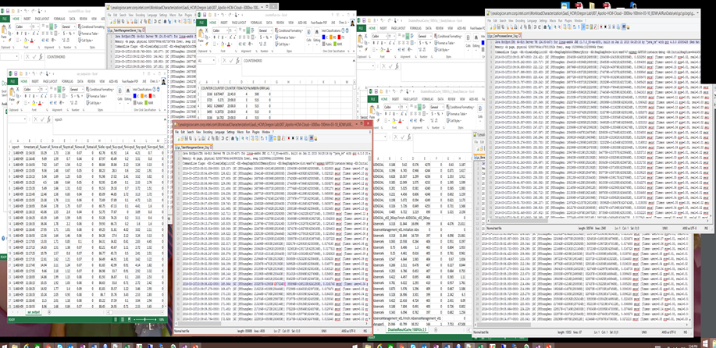
Information overload
Notes:
Unify multiple data sources of different formats
Different data sources have different time formats
Human readable time format
Epoch
Time zones
Units measurements
Some data are log files
Debug scenario. A customer escalation might demand an engineer to comb through many log files relying on expertise to find the right one
Once may have asked a single engineer to look at problems for a single application. Tend to examine one factor or source at a time but a integrated perspective is nearly always demanded.

Slide 6
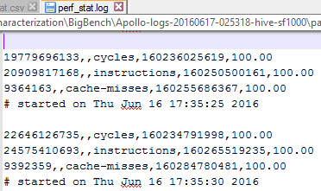
Messy, semi-structured data
Column headers are values, not variable names.
Multiple variables are stored in one column.
Variables are stored in both rows and columns.
Multiple types of observational units are stored in the same table.
Linux perf output
References
http://vita.had.co.nz/papers/tidy-data.pdf
Notes:
You’ve probably all had an introductory course in statistics. And you’ve been handed in a form needed for analysis requires variables in columns, observations in rows, one type per dataset.
That is, you’ve been handed tidy data.
In reality, we invariably begin w/ messy data.

Slide 7
Monitoring and Analytics for Cloud Performance
Instrument & Monitor
Performance & Infrastructure Data Collection
Raw Data Processing and Cleansing
Data Preparation
Analytics
Visualize, Summarize
Feedback & Learning
Analytic Discovery
Automated collection of admin logs, sar, xentop, driver, perf, …
Tune and extend
Allow data-driven inquiry via R and Shiny
Enhance our understanding of the cloud
Characterize cloud resource usage
Develop universal processing scripts
Inspire additional experimentation
Enables fast data processing at any time
Anomaly detection
Notes:
Deliver cloud computing characterization framework to collect and analyze data in Apollo Oracle cloud AMB
Provide data collection and post-processing scripts in the cloud environment
Automate the flow for performance analysis
Provide the mechanism for comparing different runs and propose interesting and relevant performance metrics to investigate
Deliver following analysis reports for all the experiments
Build intelligent system to identify VM interactions and provide placement suggestions.
Various resource utilization metrics (cpu/memory usage, i/o etc) in the cloud
Identification of resource bottlenecks
Identify i/o bottlenecks and impact of storage options (object store vs local store) for BigData as service
Build workload clustering mechanism to categorize the (anonymous) workloads in the cloud. (The categorizations are based on the interpretations of the principal components. ) This mechanism will help CSP identify representative workload types.
Identify cache contention among VMs (noisy neighbors) using RDT

Slide 8
Tidy Data Advantages
Variables are in columns, observations in rows, one type per dataset
Analysis is made possible and data visualization becomes easy
Easy correlation among the various metrics on different systems
Comparison of trends of metrics across systems
Data Processing is the most essential part of data analysis. It encompasses activities like outlier detection, data parsing, missing value imputation, etc.
tidy perf

Slide 9
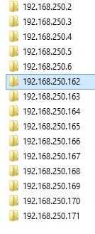
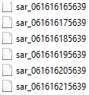
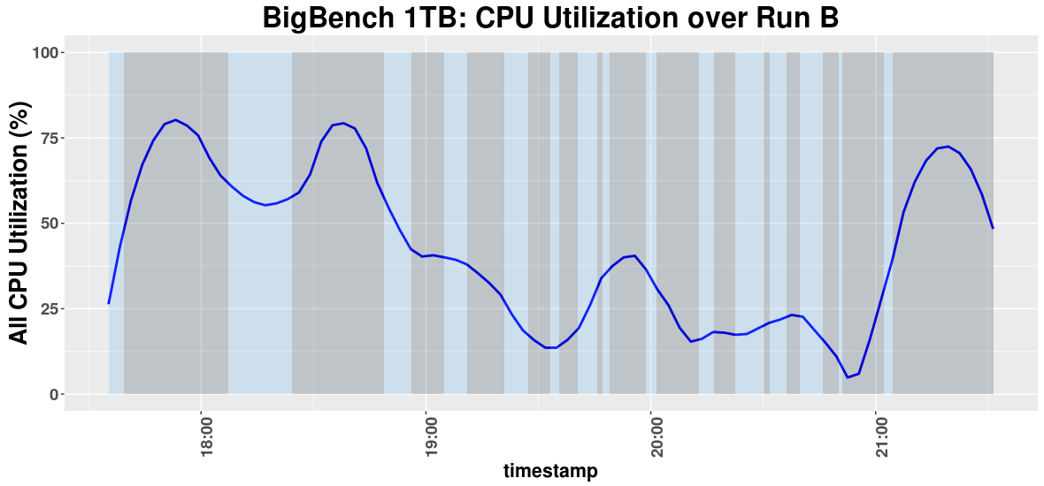
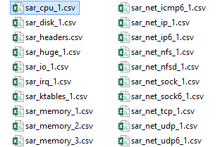
Enabling analytic data structures
A B
CPU utilization for each VM
…
raw machine-readable files
R
…and scores more for each component of interest
python
create tidy csv’s
sar broken down into components (cpu, nw, io, etc.)
9
Notes:
Over 5 hours collected, have >4GB of performance and configuration data assembled in >300 files.
Sunil (1) volume (2) messy (3) integration led by question of interest
Take only the data that we need. We can always come back for more.

Slide 11
An Overview of Software Hardware Co-optimization
For an average unit of work, it takes
the execution of N machine instructions [also called path length]
For an average instruction, it takes cycles (computer clocks) to execute it [ also called cycles per instruction, or CPI]
Check CPU Utilizations
Increase CLKs
Reduce CPI
Reduce Number of Instructions

Slide 12
Software Performance 101
Cycles Per
Instruction
CPU Utilization
Clocks
Instructions

Slide 13
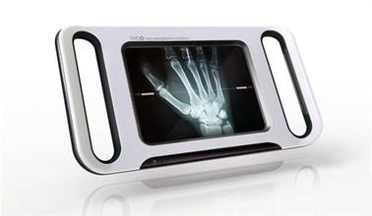
A Data Driven Approach
Bianque (扁鹊)
Collect Performance Data in the Cloud
Low Overhead Profiling
Cleanse and Process Data
Analyze Data
Root cause performance issues
Hotspots / Source Code
Cross platforms
Dash Boards

Slide 14
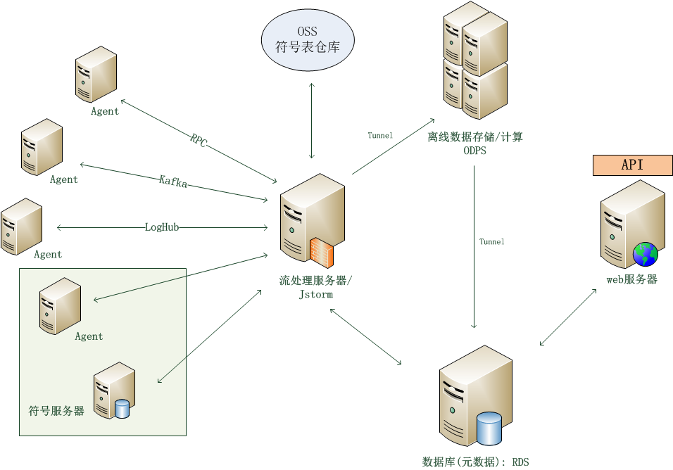
Bianque in the Cloud
14

Slide 15
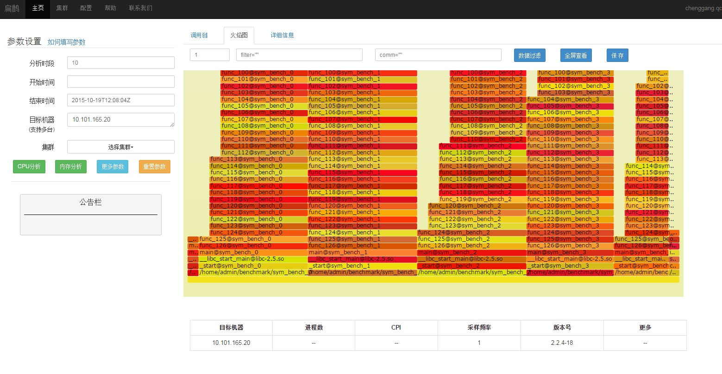
Bianque – Hotspots

Slide 16
Thank you! Any questions?
SOFTWARE QUALITY CONFERENCE
PACIFIC NW
PNSQC ™

