Slide 1
MetaAutomation: Quality Automation for Software that Matters
SOFTWARE QUALITY CONFERENCE
PACIFIC NW
Matt Griscom OctobeR 18th, 2016
PNSQC ™

Slide 2
Overview
SOFTWARE QUALITY CONFERENCE
PACIFIC NW
Quality Automation done Optimally
Paradigm Shifts
Impact on Roles
The Seven Patterns of MetaAutomation
Problems Solved!
What you can do tomorrow
PNSQC ™

Slide 3
Who am I?
SOFTWARE QUALITY CONFERENCE
PACIFIC NW
Hard-core nerd
High-level thinker
Two degrees in physics
I like hard problems
Idealistic Idiot
What do I ask of you?
Listen and keep an open mind
Ask questions
Think about the big picture
Look to what you can do tomorrow
PNSQC ™

Slide 4
Quality Automation
SOFTWARE QUALITY CONFERENCE
PACIFIC NW
Distractors:
“Test Automation” is an honest mistake
“The point of test is to find bugs”
PNSQC ™

Slide 5
Quality Automation
SOFTWARE QUALITY CONFERENCE
PACIFIC NW
New automation focus:
Answer “Does the system do what we need it to do?”
PNSQC ™

Slide 6
Quality Automation
SOFTWARE QUALITY CONFERENCE
PACIFIC NW
The core of quality automation:
“Does the system do what we need it to do?”
Best way to do functional/perf quality:
Measure fast, with accuracy and precision
Communicate efficiently across team and geography
Enable robust analysis over time
PNSQC ™

Slide 7
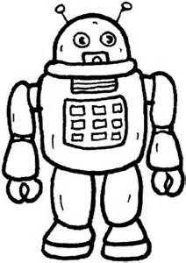
The Six Paradigm Shifts
SOFTWARE QUALITY CONFERENCE
PACIFIC NW
Quality Automation delivers very different business value from the manual test role
PNSQC ™

Slide 8
The Six Paradigm Shifts
SOFTWARE QUALITY CONFERENCE
PACIFIC NW
Optimized Quality Automation vastly increases business value
PNSQC ™

Slide 9
The Six Paradigm Shifts
SOFTWARE QUALITY CONFERENCE
PACIFIC NW
Checks are bounded in time, enabling structured artifacts
Automation (e.g. industrial or utility)
… log … log… log … log log log … log …… log … log log … log … log … log…
Conventional “Test Automation” …
… LOG… log… log… log log log… log…… log… log log… log… log… log…
Quality Automation implemented with patterns of MetaAutomation …
<Check>… (hierarchical steps +contextual data) … </Check>
PNSQC ™

Slide 10
The Six Paradigm Shifts
SOFTWARE QUALITY CONFERENCE
PACIFIC NW
The Hierarchical Steps pattern gives transparency, robustness, and flexibility
PNSQC ™

Slide 11
The Six Paradigm Shifts
SOFTWARE QUALITY CONFERENCE
PACIFIC NW
Measure Quality with multi-tier checks for the Internet of Things
Bluetooth
Tier
Tier
PNSQC ™

Slide 12
The Six Paradigm Shifts
SOFTWARE QUALITY CONFERENCE
PACIFIC NW
Better quality data empowers the whole team across geographies and across the SDLC
Leads and Managers
Executive
Geography
Test
Developers
Geography
Geography
QA
PNSQC ™

Slide 13
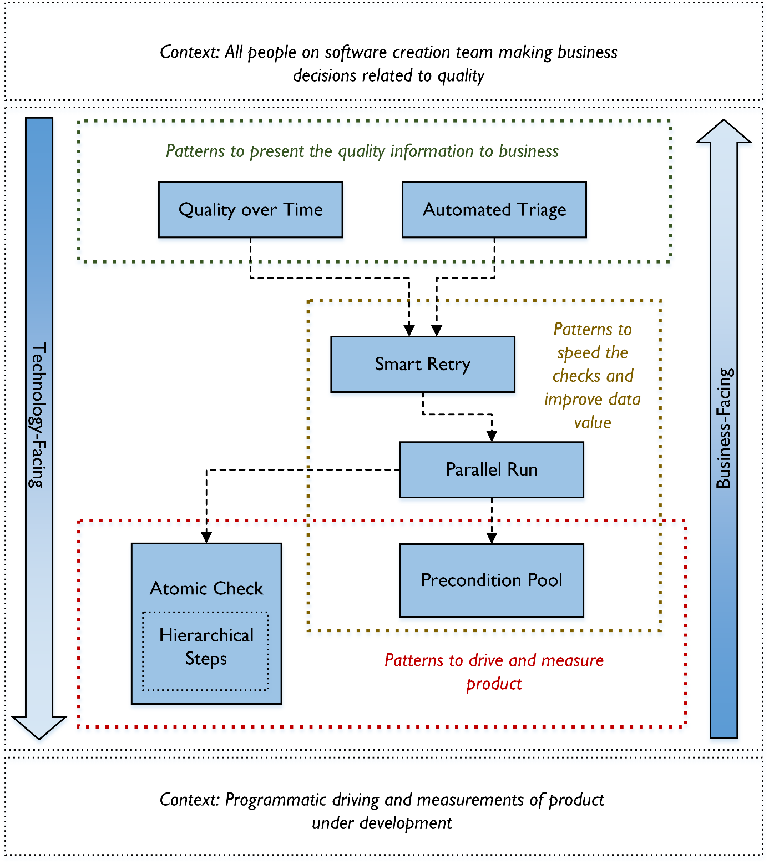
SOFTWARE QUALITY CONFERENCE
PACIFIC NW
PNSQC ™
Notes:
Context: SUT -> Context: business -> Context:patterns to drive, Context: patterns to speed -> Context: patterns to present

Slide 14
MetaAutomation solves these problems…
SOFTWARE QUALITY CONFERENCE
PACIFIC NW
Slow checks
Flaky checks
Ignored failures
Secret QA knowledge
Test script documentation load
Under-appreciated QA role
Separate performance checks
Lack of intra-team and cross-geography trust, respect
SOX is missing information
PNSQC ™

Slide 15
Team Happiness!
SOFTWARE QUALITY CONFERENCE
PACIFIC NW
The team is unified
There is more clarity that people are doing their best work
PNSQC ™

Slide 16
SOFTWARE QUALITY CONFERENCE
PACIFIC NW
Hey, if this stuff is so great, why is nobody doing it?
PNSQC ™
Notes:
Go back to diagram slide to discuss

Slide 17
What can you do tomorrow for greater business value from automation?
SOFTWARE QUALITY CONFERENCE
PACIFIC NW
Document requirements
Business vs. functional requirements
Short, simple, independent checks
No extraneous verifications
Be clear on what checks verify, and what they don’t
PNSQC ™

Slide 18
Closing
SOFTWARE QUALITY CONFERENCE
PACIFIC NW
“Test Automation” -> Quality Automation
Six Paradigm Shifts
Impact on Roles
The Seven Patterns of MetaAutomation
Problems Solved!
Ideas to use starting tomorrow
PNSQC ™

Slide 19
SOFTWARE QUALITY CONFERENCE
PACIFIC NW
Questions?
PNSQC ™
Notes:
Go back to diagram slide to discuss

Slide 20
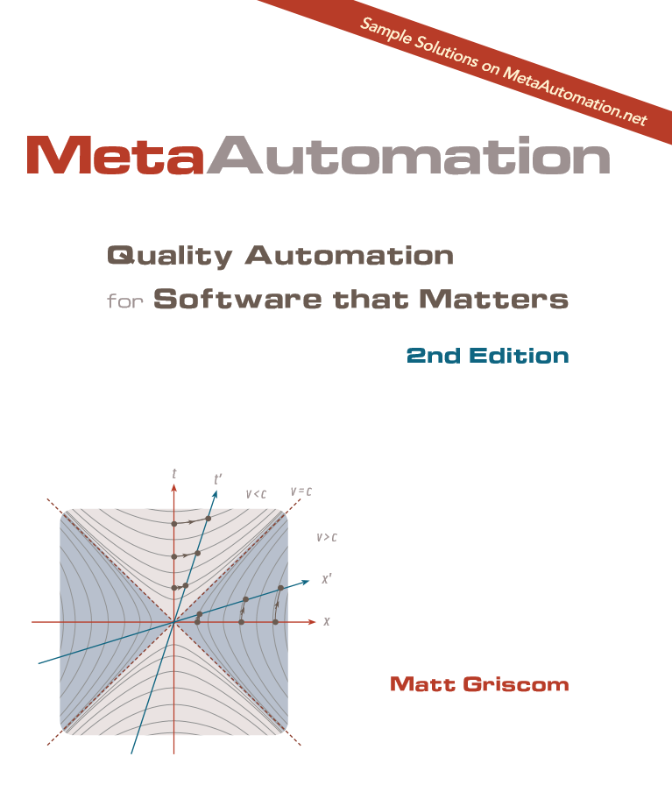
MetaAutomation
SOFTWARE QUALITY CONFERENCE
PACIFIC NW
http://metaautomation.net
matt@metaautomation.net
PNSQC ™
Notes:
Give away books

