Slide 1
The Three Tenets of Engineering Motivation
(How) do they apply to QA?

Slide 2
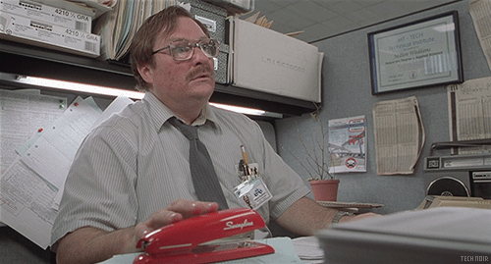
If your job sucks, how can you love your work?

Slide 3
First Things First...
Notes:
Compensation matters.
If you aren’t paying and rewarding your employees competitively, the rest won’t matter, with few exceptions.
If you aren’t paid well, get another job.
This takes work.
Motivate yourself via the following three tenets!

Slide 4
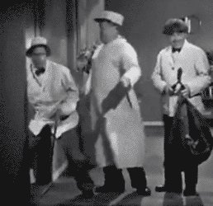
The three...
Autonomy, Mastery, and Purpose.
Control of destiny
Level up!
A feeling of contribution
Notes:
First rule of presenting: Don’t blow the punch line. (split these into individual pages)
Automomy
Give employees real determination over aspects of their work
Trust in them to make mistakes and learn from them
Foster an environment in which mistakes are encouraged
Mastery
Always be improving; everything
Gaming generation
Requires instant feedback
Solving problems/puzzles
Tasks as challenges; goldilocks
Too easy: bored
Too hard: fear
Purpose
Hardest and most rewarding
cause larger than yourself
Provides own motivation to tackle difficult problems
Connect work to people and values (explain how to do this in qa)

Slide 5
The… four?
Tony Hsieh lists four[6]:
A sense of control (autonomy)
Perceived progress (mastery)
Connectedness (team, aka: purpose?)
Vision and meaning (purpose)
Notes:
Less is more, right?
3 tenets!
Seven minute abs!
Team is important, and can be isolated.
Each of these tenets could be expanded or implemented in any way
The more the better
Connectedness can be viewed as a part of purpose
We are social animals
Keep your remote employees close via dedicated incentives (you hired them, make them part of the team)

Slide 6
Unhappiness aka: jobs?
Notes:
Jobs suck
Computers suck
Management is worse (amirite?)
When people hate their jobs, even if they love their work, they are not as productive as they could be[1]
Is it lack of pay? Recognition? Maybe, but surprisingly most engineers don’t primarily respond to these uncontrollable career aspects
Managers and ICs can do other things to make their people or themselves feel and be happy in their jobs
And therefore be more productive
When people are paid fairly three other things drive us to solve difficult problems and enjoy doing it

Slide 7
Isn’t everyone unhappy at work?
In short.. no
Notes:
First “real” engineering job. Fortune 500, three letter name, lots of “blue”
Execs were tired of spell checking technical terms and acronyms
Only deliverable: dictionary of these things <sigh>
Dating myself
Worst. Internship. Ever.
Do something about it
Automate the process (osx WARP, remember that one?)
Autonomy (found my own solution)
Mastery (new OS, new tools)
Purpose in the learning (for me)

Slide 8
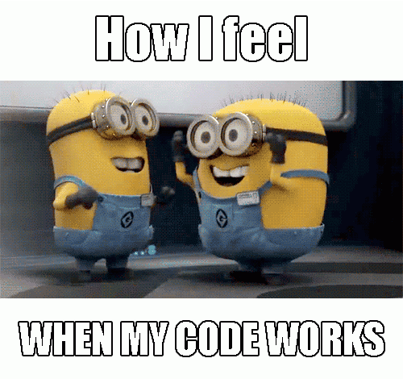
Who cares if people are happy?
Happiest people tackle the most challenging problems[2]
When people are happy they produce more, faster and better: "happiness advantage"[4] (Shawn Achor)
When people go home satisfied, they relax better, treat their families better. they produce more, faster, better [3]
Notes:
This is business, not a playground!
Do you want to work or play?
Why not both?
If work is play, it’ll feel autonomous, mastery will come with repetition, part of purpose can be found in having fun!
This cycle is self-fulfilling.

Slide 9
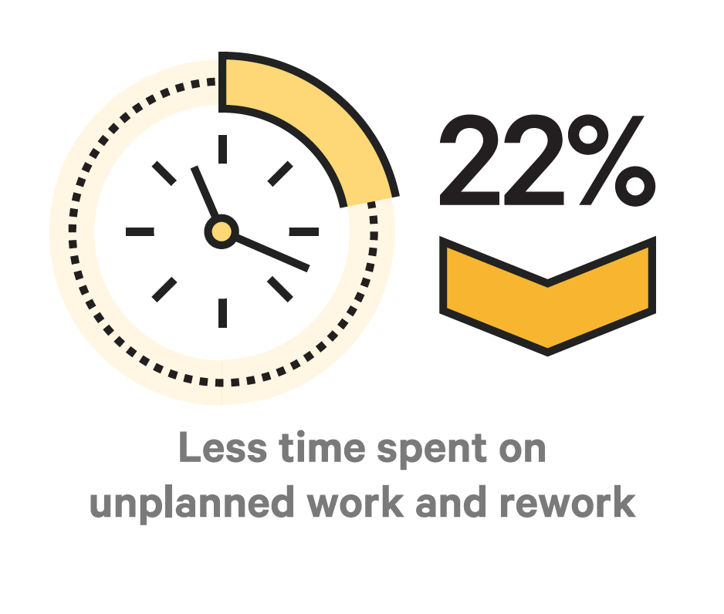
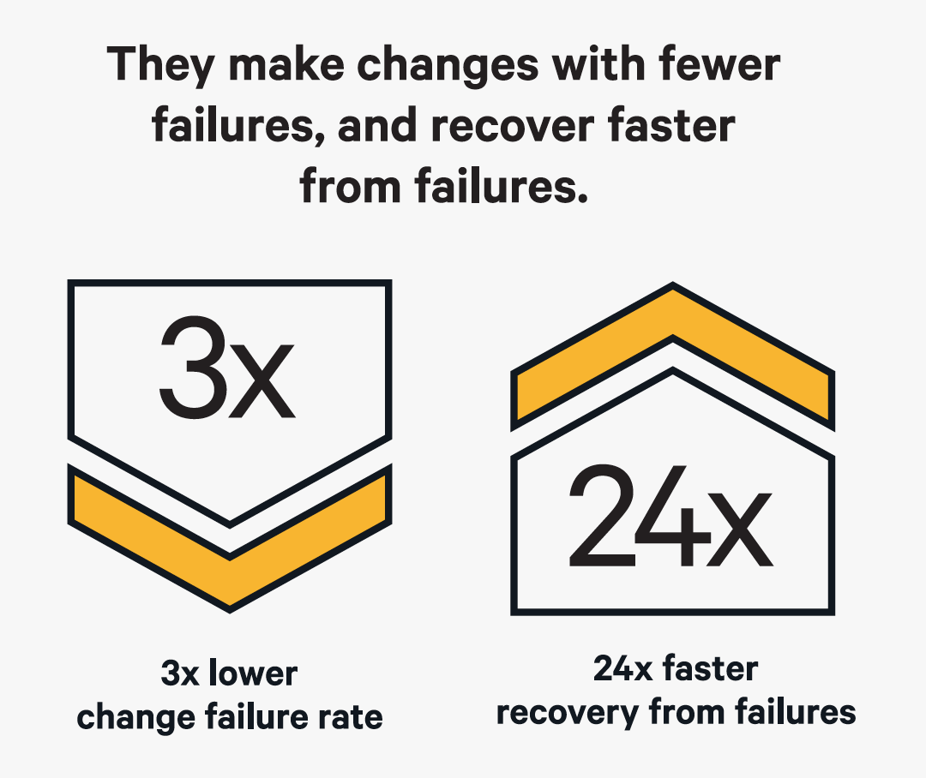
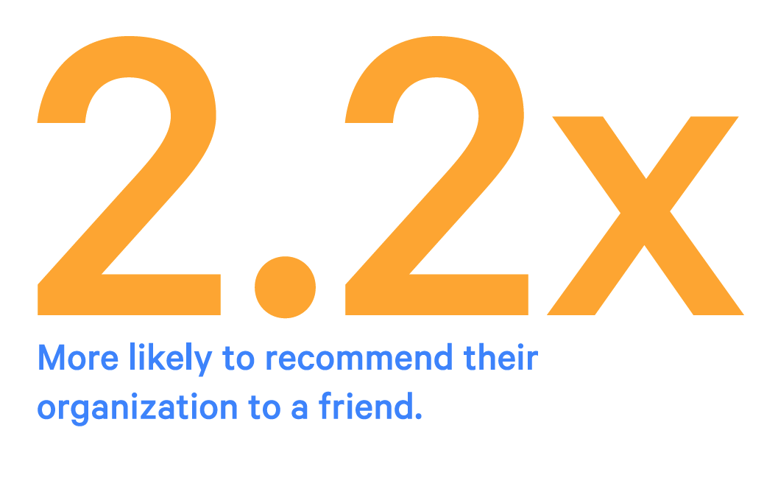
What happens when your teams are high performing
[5]

Slide 10
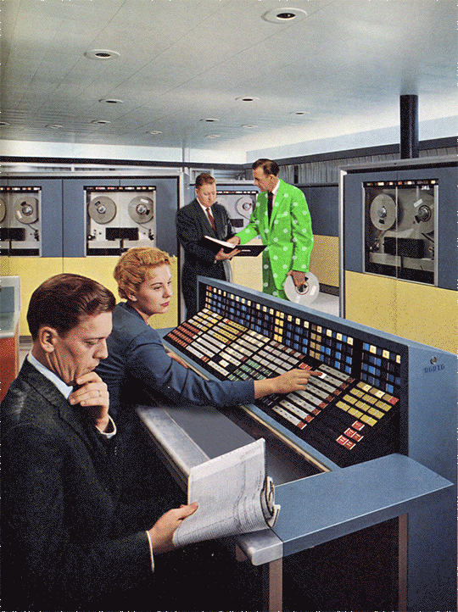
Where do the tenets apply?
Semiconductor Design?
Simulation software for instant feedback (mastery)
Lots of puzzles (circuit design, autonomy)
Contribute to a huge chip (purpose)
Notes:
These apply to all sorts of engineering disciplines, so why not QA?
TODO: for each of these (3 slides) have the punchlines expose one by one, replace gif per each?
In semiconductor design the feedback loop is extremely long, can be years until you test a design
Simulation software allows engineers to simulation and close the feedback loop
Software allows a feeling of mastery (level up)
Automony just like in most engineering disciplines through creativity
Purpose can be large: (i have circuits in that processor! I saved the world (circuits in defense projects))
Or just: team is important! Friendly competition!

Slide 11
Interior Design?
Notes:
Modeling a future design in photoshop? Could even do it in excel
Autonomy: finding your own solutions
Mastery: new tool, will this thing work??
Purpose: better living through technology!
Relay story:
We were supposed to go camping, but we found ourselves arranging furniture in sketch-up inside, on a sunny day!

Slide 12
Most importantly: QA?
Autonomy:
Find own way to bugs/solutions
Mastery:
Tons of languages, styles, software types
Purpose:
Users, if you are lucky
Ownership shares, if you are very lucky
Puzzles!
Notes:
Of course!
I guess if you are at this con, i don’t have to tell you how QA is the coolest
One big puzzle! (mastery) See if you can break this thing (purpose) Find your own way (autonomy)
Team! Help the devs! You are embedded with your devs, right?

Slide 13
Maybe we can’t retain
SW: 3-4 year job cycle
Older generation sees layoffs
Encourage best work while on-board
Process efficiencies
On-boarding efficiencies
Autonomy, Mastery, and Purpose!
Notes:
(and maybe this is ok?)
As ICs, Layoffs feel imminent after years of loyal service
Especially at big companies
Might love the work, but hate the job/company

Slide 14
So what do we do?
Notes:
If you are a manager:
Foster an environment where they can feel Autonomy, Mastery and Purpose
Ensure they take steps in each facet
If you are an IC, (and unhappy)
Find another job (if you are lucky)
Make the best of it while you are stuck in that place
Find ways to make a dent with purpose, your own direction and level up your knowledge to get that next better job
As managers, team leads:
Encourage longer tenures through the three tenets,
Make a culture so good, they have to pay attention
force them to love the work AND the job
All companies can do this through proper management
All managers and leaders can do this in a bubble inside a rotten environment
All employees can do this to get through a tough tenure and hopefully move on
Meanwhile: Happiness is contagious
Encourage their next adventure, while regretting their loss of contributions
Others feel this, and feel they can expand their careers in ways that are right to them

Slide 15
What happens when your teams are high performing
[5]
Notes:
Reminder ^^
Just to review my punchline…

Slide 16
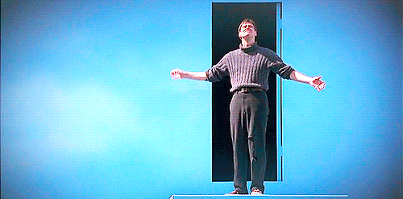
Acks/Citations
Everyone @ Puppet!
HR @ Puppet (hiring)
Management @ Puppet (motivational gurus)
Dan Pink: http://www.danpink.com/books/drive/
[1] http://cdp.sagepub.com/content/20/4/265.abstract
[2] https://hbr.org/2013/04/to-find-happiness-at-work-tap.html
[3] Common Sense
[4] http://goodthinkinc.com/resources/books/the-happiness-advantage/
[5] https://puppet.com/resources/white-paper/2016-state-of-devops-report
[6] http://deliveringhappiness.com/book/

