Slide 1
Transforming Organizations to achieve TMMi certification
SOFTWARE
QUALITY
CONFERENCE
PACIFIC NW
[Presented by] Suresh Chandra Bose, Ganesh Bose
[Presented DATE] 17th Oct, 2016
SureshChandra.GaneshBose@cognizant.com
PNSQC ™

Slide 2
Biography
SOFTWARE
QUALITY
CONFERENCE
PACIFIC NW
Suresh Chandra Bose, Ganesh Bose is a Manager Consulting at Business Consulting practice of Cognizant Technology Solutions. Suresh is an accredited Lead Assessor from TMMi Foundation and has been in the IT Industry for more than 18 years with vast Consulting experience in various industries and executed Strategic initiatives for various Fortune 100 companies in the areas of PMO, PPM, Process Consulting, Program Management, TMMI assessment/implementation, Organization Strategy, Test Consulting and CIO/Governance Dashboard/Metrics for various clients across the globe.
Suresh is the 1st and only TMMi Lead Assessor in North and South America.
He holds 18 International IT Certifications and is also a speaker in multiple International conferences like ASQ, ASTQB and PNSQC.
SureshChandra.GaneshBose@cognizant.com
PNSQC ™

Slide 3
Key points and Overview of Content
SOFTWARE
QUALITY
CONFERENCE
PACIFIC NW
Introduction to TMMi
Need for TMMi Assessment
Comparison - CMMi and TMMi
Improvement Roadmap for Implementation
Assessment Approach
TMMi Assessment Maturity Rating Methodology
Sample Implementation Roadmap
Benefits and Projected Savings
References
PNSQC ™

Slide 4
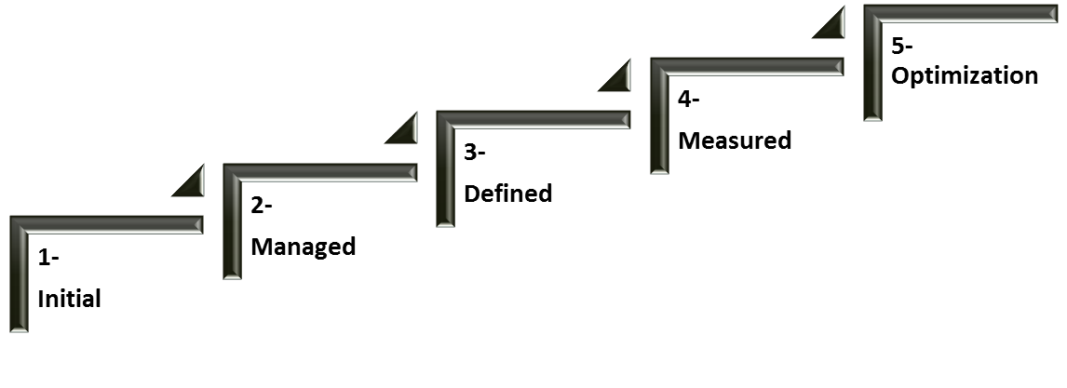
Introduction to TMMi
SOFTWARE
QUALITY
CONFERENCE
PACIFIC NW
TMMi is “Test Maturity Model integration”
Developed by the TMMi Foundation
Contains guidelines and framework for test process improvement
Has 5 maturity levels for process evaluation in systems and software engineering
Addresses cornerstones of structured testing: lifecycle, techniques, infrastructure and organization
Provides a detailed model for test process improvement
By far the most popular model in the industry for benchmarking testing practices
Performs assessment considering the level at which an organization wants to be appraised
Positioned as being complementary to CMMi
PNSQC ™

Slide 5
Need for TMMi Assessment
SOFTWARE
QUALITY
CONFERENCE
PACIFIC NW
The reasons why Organizations can benefit from a TMMi assessment are many and can be broadly grouped as follows:
Integration of industry best practices with the testing process to achieve business objectives
As IT is getting more complex, there is a need to show value to our customers
Evaluating the current testing process against Industry standards to enhance credibility in market place (benchmarking)
Standardizing and optimizing the testing process along with higher degree of process compliance
Assess efficiency of support functions like Environment, Test Data, Build Management, Non-Functional Testing, etc. ,for testing activities
Effective monitoring and control mechanism to mitigate schedule and cost overruns and quality issues
PNSQC ™

Slide 6
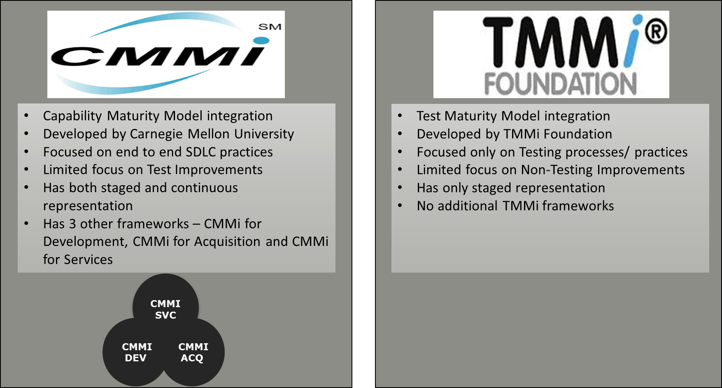
Comparison - CMMi and TMMi
SOFTWARE
QUALITY
CONFERENCE
PACIFIC NW
Though TMMi is positioned as being complementary to CMMi and follows the same structure outlined by CMMi, there are some significant differences between the two.
PNSQC ™

Slide 7
Improvement Roadmap for Implementation
SOFTWARE
QUALITY
CONFERENCE
PACIFIC NW
There are five levels of maturity in TMMi: starting from a level of being ad hoc and unmanaged, to improving in maturity to one which is managed, then defined, measured, and finally optimized.
Level 1 - Initial: There are no defined process areas to be considered level 1. This means any organization regardless of whether they have any testing process can be considered at level 1. The actual maturity rating starts from level 2 upwards.
Level 2 - Managed: This level has 5 process areas starting from Test policy and Strategy. The process here is considered stable and can repeat the tasks at the project level.
Level 3 - Defined: Level 3 is standardization of processes at the organization level and also has 5 process areas.
Level 4 – Measured: This level is quantitatively managed with focus on measurement, product quality and advanced peer reviews.
Level 5 – Optimized: The organization is capable of continually improving its processes based on a quantitative understanding of statistically controlled processes. The testing techniques are optimized with continuous focus on fine tuning and process improvement.
PNSQC ™

Slide 8
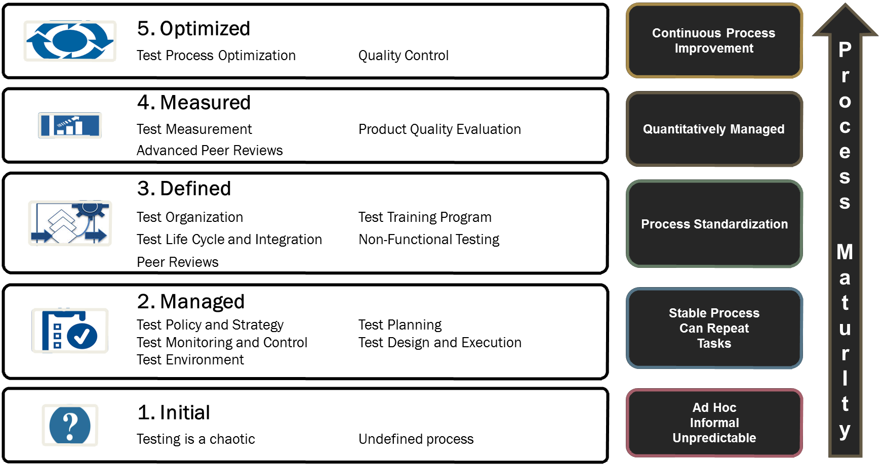
Process Areas
SOFTWARE
QUALITY
CONFERENCE
PACIFIC NW
PNSQC ™

Slide 9
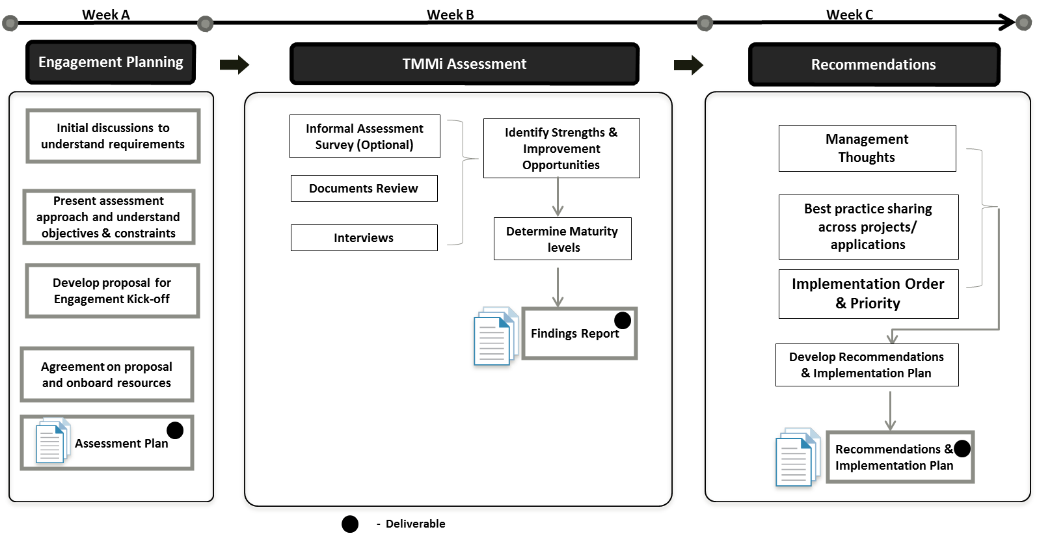
Assessment Approach
SOFTWARE
QUALITY
CONFERENCE
PACIFIC NW
Based on the outcome of the findings report, recommendations are developed for every gap identified and they are prioritized based on the inputs from the organization. A detailed Implementation roadmap is finally developed with timelines for all the prioritized recommendations.
PNSQC ™

Slide 10
TMMi Assessment Maturity Rating Methodology
SOFTWARE
QUALITY
CONFERENCE
PACIFIC NW
The rating process strictly adheres to what is laid out in TMMi Assessment Method Application Requirements (TAMAR) which defines the requirements considered essential to Assessment methods intended for use with the TMMi framework.
There are 16 process areas, 77 goals and 345 practices including the specific and generic practices from level 2 to level 5. The interviews and document evidence are rated for all the specific and generic practices which are rolled up to the goals, then to process area, and finally to the maturity level.
PNSQC ™

Slide 11
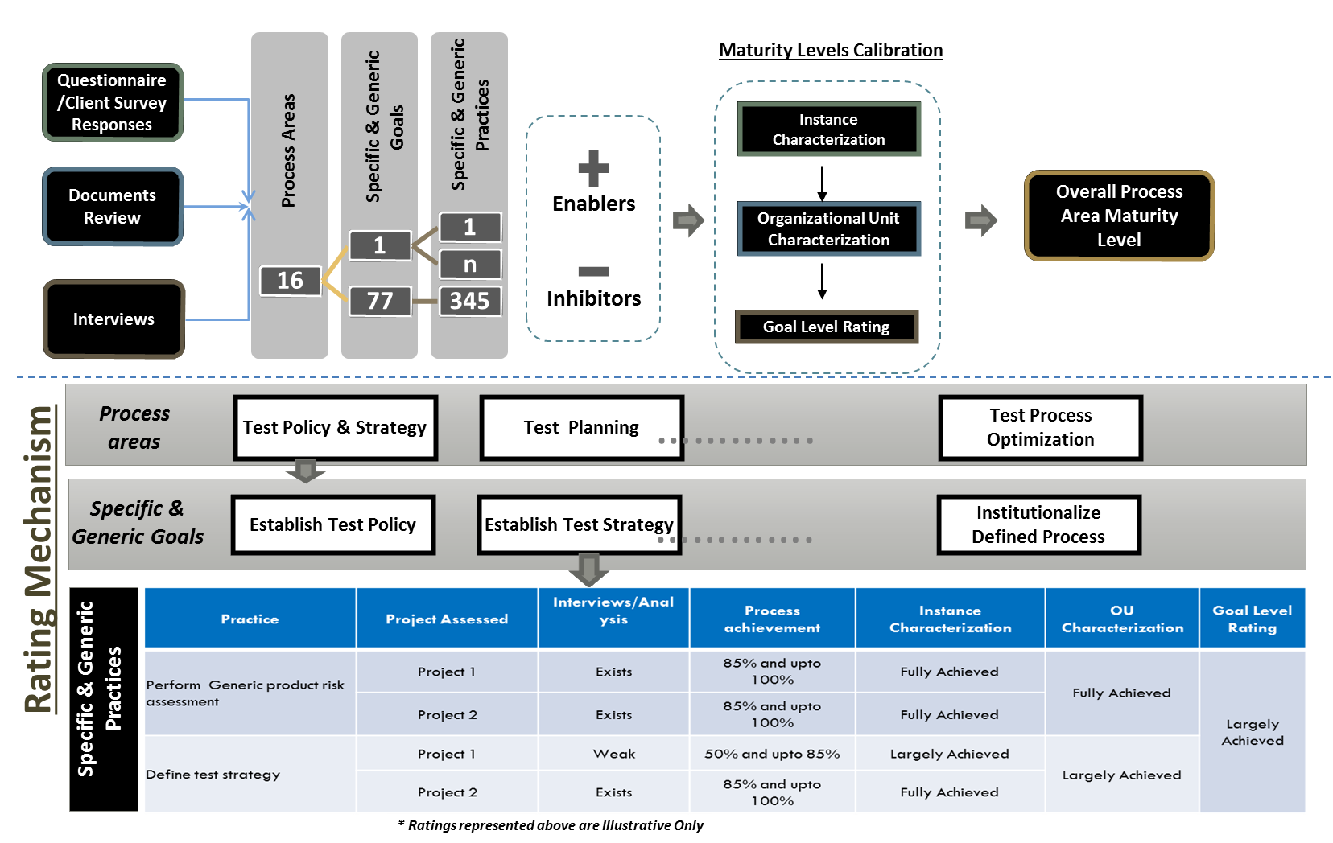
TMMi Assessment Maturity Rating Methodology
SOFTWARE
QUALITY
CONFERENCE
PACIFIC NW
PNSQC ™

Slide 12
TMMi Maturity Level Calibration Guidelines
SOFTWARE
QUALITY
CONFERENCE
PACIFIC NW
Process Areas are designated the appropriate maturity levels based on the following guidelines
Fully Achieved -
  Convincing evidence of process compliance
  Systematic and widespread implementation of process
  No obvious weakness in distribution, application and results of this process exists
  Process achievement is between 85% and up to 100%
Largely Achieved –
  Significant evidence of process compliance
  Minor weakness in distribution, application and results of this process exists
  Process achievement is between 50% and up to 85%
Partially Achieved –
  Some evidence of process found
  Process exhibits significant weaknesses, is incomplete, not widespread, or inconsistent in application or results.
  Process achievement is between 15% and up to 50%
Not Achieved -
  Little or no evidence of process
  Process achievement is between 0% and up to 15%
Not Rated - Any supporting goal that cannot be rated based on the current phase of the project must be “Not Rated”
Not Applicable - The process area is considered not to be in the scope of the assessment or applicable to the organizational unit by the Lead Assessor
PNSQC ™

Slide 13
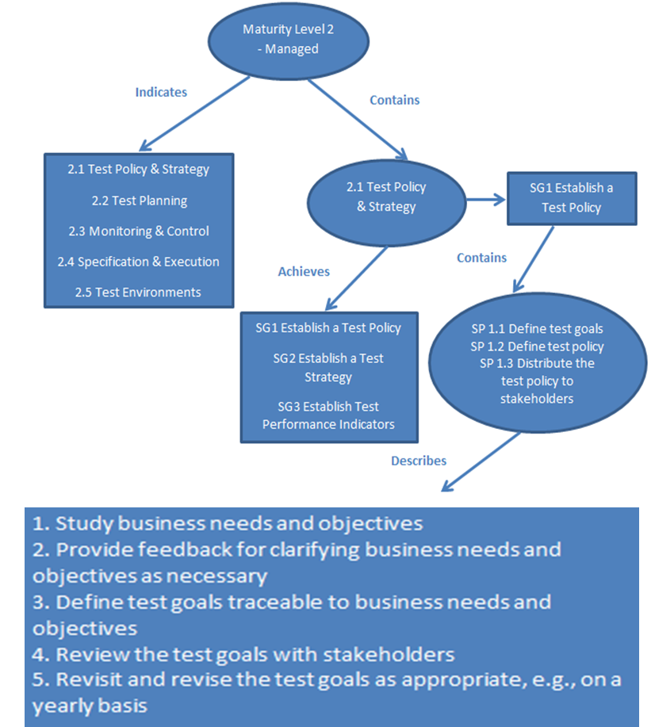
Example of Roll up
SOFTWARE
QUALITY
CONFERENCE
PACIFIC NW
Let’s take the process area “Test Policy and Strategy” from level 2 as an example to clearly explain how the sub-practice contributes to the roll up of rating to the process area level. Sub-practice is an informative model component that provides guidance for interpreting and implementing a specific or generic practice.
PNSQC ™

Slide 14
Sample Implementation Roadmap
SOFTWARE
QUALITY
CONFERENCE
PACIFIC NW
Sample
PNSQC ™

Slide 15
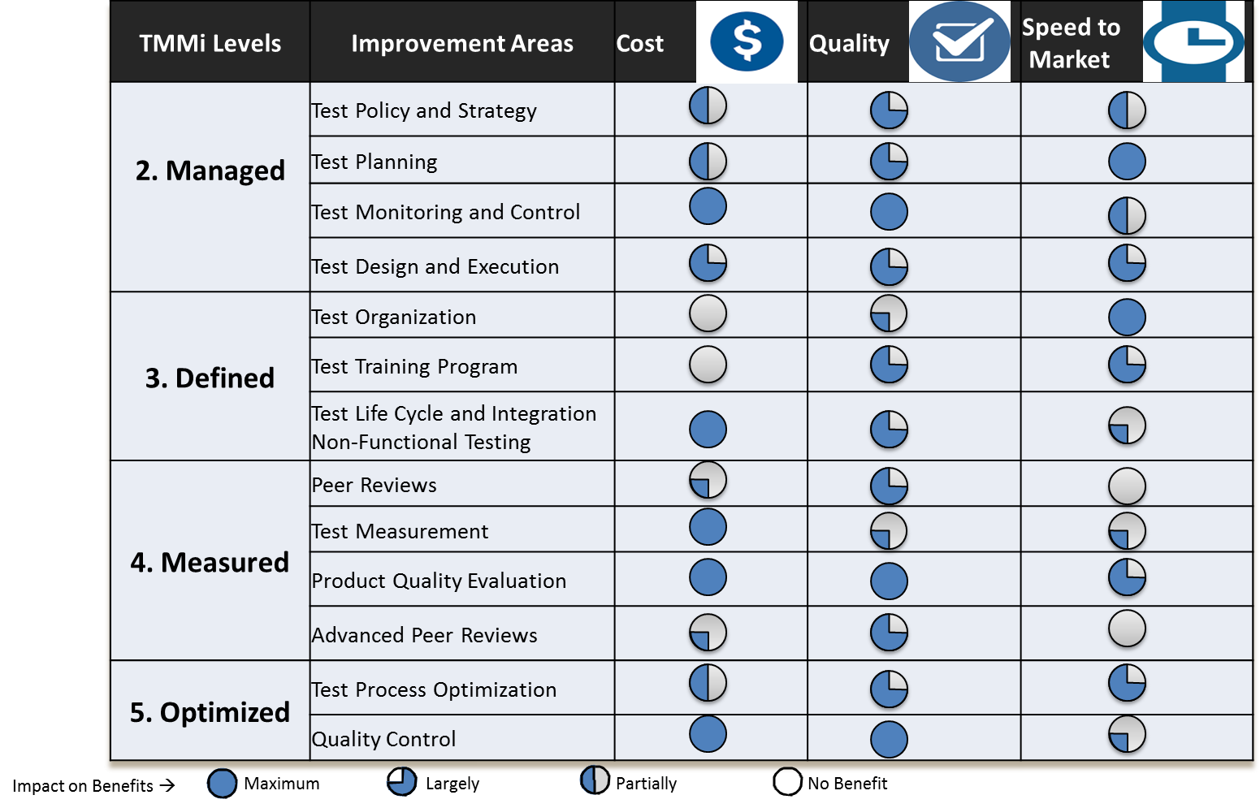
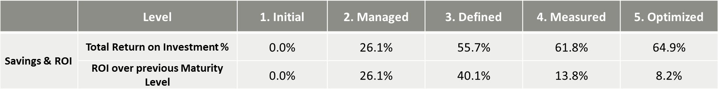
Benefits and Projected Savings
SOFTWARE
QUALITY
CONFERENCE
PACIFIC NW
PNSQC ™

Slide 16
References
SOFTWARE
QUALITY
CONFERENCE
PACIFIC NW
Suresh Chandra Bose, Ganesh Bose. “How to Take Organizations to Higher Testing Maturity” ASTQB Conference, 2015
https://www.astqb.org/certified-tester-resources/astqb-software-testing-conference/conference-agenda/how-to-take-organizations-to-higher-testing-maturity/
TMMi Foundation Reference Model
http://www.tmmi.org/pdf/TMMi.Framework.pdf
“Dell Enterprise Validation First in North America to achieve TMMi Certification”
http://en.community.dell.com/dell-blogs/dell4enterprise/b/dell4enterprise/archive/2016/04/26/dell-enterprise-validation-first-in-north-america-to-achieve-tmmi-certification
PNSQC ™

Slide 17
Contact Me @
SOFTWARE
QUALITY
CONFERENCE
PACIFIC NW
Suresh Chandra Bose Ganesh Bose
SureshChandra.GaneshBose@cognizant.com
www.linkedin.com/in/gsubose/
https://twitter.com/gsubose
PNSQC ™

Slide 18
SOFTWARE
QUALITY
CONFERENCE
PACIFIC NW
Questions?
PNSQC ™

Slide 19

SOFTWARE
QUALITY
CONFERENCE
PACIFIC NW
PNSQC ™

