Slide 1
Improving Cross Functional Collaboration
SOFTWARE QUALITY CONFERENCE
PACIFIC NW
DAIN CHARBONNEAU 10/09/2018
PNSQC ™

Slide 2
Agenda
SOFTWARE QUALITY CONFERENCE
PACIFIC NW
What is Cross Functional Collaboration?
Why we should care?
Processes and techniques that promote cross functional collaboration.
PNSQC ™

Slide 3
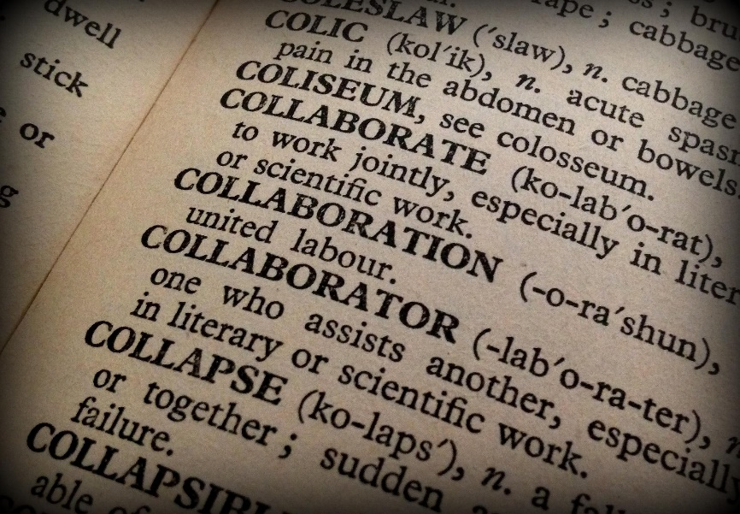
What is cross functional collaboration?
SOFTWARE QUALITY CONFERENCE
PACIFIC NW
Collaboration - to work jointly with others or together especially in an intellectual endeavor
Cross-functional - involving people or departments who do different types of work for the same company
PNSQC ™

Slide 4
SOFTWARE QUALITY CONFERENCE
PACIFIC NW
Why does cross functional collaboration matter?
This Photo by Unknown Author is licensed under CC BY-NC-ND
PNSQC ™

Slide 5
SOFTWARE QUALITY CONFERENCE
PACIFIC NW
Have you experienced failures do to poor collaboration?
Defects introduced into production.
Project is overbudget.
Delayed or missing project deadlines.
PNSQC ™

Slide 6
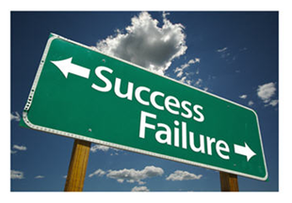
SOFTWARE QUALITY CONFERENCE
PACIFIC NW
“86 PERCENT OF EMPLOYEES CITE LACK OF COLLABORATION FOR WORKPLACE FAILURES”
Fierce, Inc, 2011, https://fierceinc.com/employees-cite-lack-of-collaboration-for-workplace-failures
This Photo by Unknown Author is licensed under CC BY-NC-ND
PNSQC ™
Notes:
Over 1,400 corporate executives, educators and individual contributors across multiple industries by Fierce, Inc in 2011

Slide 7
SOFTWARE QUALITY CONFERENCE
PACIFIC NW
Cross functional collaboration.
Pool talents and strengths, self analyze, and receive input.
Personal Skill Building
PNSQC ™

Slide 8
SOFTWARE QUALITY CONFERENCE
PACIFIC NW
“Workplace collaboration helps create an environment where employees feel valued for their unique skills as well as their input.”
Smarksheet, accessed October 2018, https://www.smartsheet.com/how-workplace-collaboration-can-change-your-company
PNSQC ™
This Photo by Unknown Author is licensed under CC BY-SA-NC

Slide 9
SOFTWARE QUALITY CONFERENCE
PACIFIC NW
“Companies that promoted collaborative working were 5 times as likely to be high performing.”
Forbes, 2017, https://www.forbes.com/sites/adigaskell/2017/06/22/new-study-finds-that-collaboration-drives-workplace-performance/#148997b43d02
PNSQC ™
Notes:
the Institute for Corporate Productivity (i4cp) and Rob Cross, Edward A. Madden Professor of Global Business at Babson College
The study examined over 1,100 companies

Slide 10
Collaboration is a key driver of company performance: Based on a 2006 Frost & Sullivan study. https://e-meetings.verizonbusiness.com/maw/pdf/MAW_white_paper.pdf
SOFTWARE QUALITY CONFERENCE
PACIFIC NW
Product Quality
Development and Innovation
Employee Productivity
Financial Performance
Customer Satisfaction
PNSQC ™
Notes:
Frost & Sullivan, together with Verizon Business and Microsoft, undertook a research program to understand how global enterprises use collaboration in their business.
Collaboration Index, which measures how collaborative businesses are, and illuminates the relationship between collaboration and business performance.

Slide 11
SOFTWARE QUALITY CONFERENCE
PACIFIC NW
Processes and techniques that promote cross functional collaboration.
PNSQC ™

Slide 12
Collaboration using demos.
SOFTWARE QUALITY CONFERENCE
PACIFIC NW
Have you received or given a demo in the last month?
How about a demo outside of you team?
Why not?
This Photo by Unknown Author is licensed under CC BY-SA-NC
PNSQC ™

Slide 13
SOFTWARE QUALITY CONFERENCE
PACIFIC NW
Developer demo to QA
“I just don’t understand what I am being asked to test.”
This Photo by Unknown Author is licensed under CC BY-NC-ND
PNSQC ™
Notes:
spontaneous meetings, whiteboard sessions, and conversations.

Slide 14
SOFTWARE QUALITY CONFERENCE
PACIFIC NW
Demo to stakeholders and users.
Use demo’s to shift left.
Demo as part of the UAT handoff.
PNSQC ™
Notes:
Demo for User acceptance testing, but also demo earlier in the process. Keeps people engaged in the project.

Slide 15
SOFTWARE QUALITY CONFERENCE
PACIFIC NW
Pairing
Developer and Quality Assurance pairing during bug investigation.
Pairing during UAT and with partner users.
This Photo by Unknown Author is licensed under CC BY-SA
PNSQC ™
Notes:
Don’t influence the experience by showing or explaining expectations.
Have the stakeholder use the product without giving steps. Provide them with a task and see how the task is completed. Many times, a behavior outside of expectations will be observed. If the user can not figure out how to complete the task on their own. Then there may be a UX design flaw.
Ask about scenarios that are not used. Are there better ways or does the user not know about capabilities.
Conducting multiple sessions with different users, especially if there are multiple groups that use the feature. Do different groups use the different ways?
Smaller “focus groups” with 2 to 3 people max. Larger groups will drown people out, especially with direct reports in the room. People seem to be less vocal on opinions when their boss is present.
Have multiple sets of keyboards and mice set up. This encourages getting others involved rather than only one person driving with the mouse and keyboard.
Consider inviting a developer or two to attend. Developers can also learn for observing how the feature is used in the real world.
Prepare what if questions. E.g. If a feature breaks what do you do? If someone asks you to do something, how do you do it? If you could improve something about this flow, what would it be?

Slide 16
SOFTWARE QUALITY CONFERENCE
PACIFIC NW
Test case reviews.
Engage developers and subject matter experts.
Reduce any potential holes in testing coverage.
Personal growth and learning through feedback.
PNSQC ™

Slide 17
SOFTWARE QUALITY CONFERENCE
PACIFIC NW
Daily Stand-ups?
What does your daily ritual look like?
PNSQC ™
Notes:
It is a brief team meeting intended for the entire team to stay up-to-date and to quickly resolve bottlenecks, usually guided by three standard questions:
What did you do yesterday?
What will you do today?
What is blocking your progress?
Stand are motivation killers / mood killers
A tool used to fight dysfunction.

Slide 18
SOFTWARE QUALITY CONFERENCE
PACIFIC NW
Stand-ups for non-centralized employees and large teams
This Photo by Unknown Author is licensed under CC BY-NC
This Photo by Unknown Author is licensed under CC BY-NC-ND
PNSQC ™

Slide 19
SOFTWARE QUALITY CONFERENCE
PACIFIC NW
Asynchronous Stand-ups
Asynchronous - Events not happening at the same time.
Stand-ups that are typically managed through a chat bot.
Saved record allows past stand-ups to be referenced.
Conflicting meetings are not a problem as the stand-up content can be reviewed as availability allows.
Convenient for remote team members, attendees.
Alternative to scrum of scrums for large groups.
PNSQC ™

Slide 20
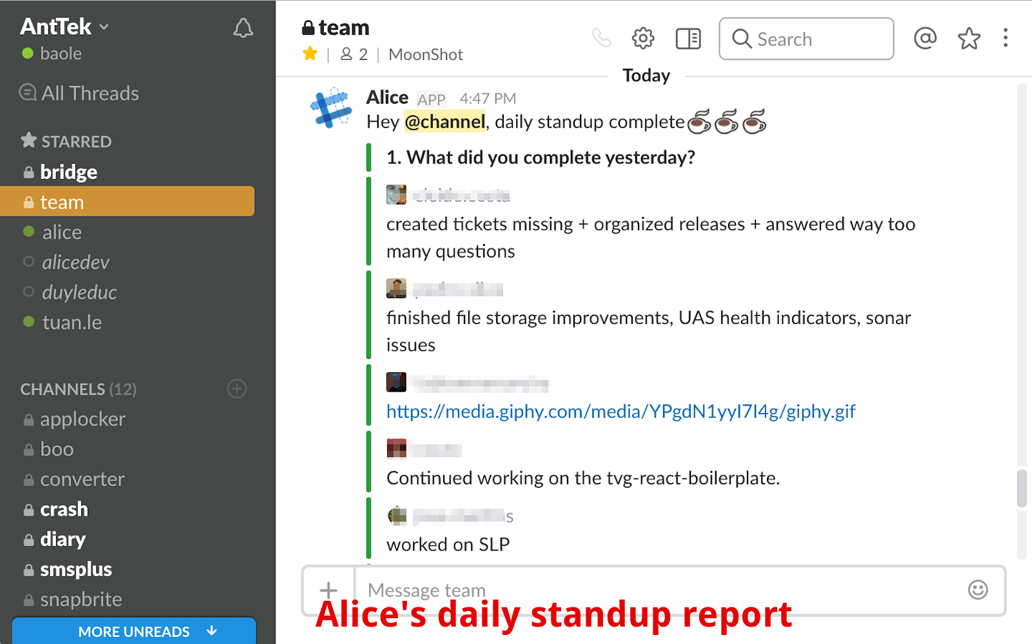
Stand-up Alice in Slack
SOFTWARE QUALITY CONFERENCE
PACIFIC NW
PNSQC ™

Slide 21
Concerns with Asynchronous Stand-ups
SOFTWARE QUALITY CONFERENCE
PACIFIC NW
There is a delay with dealing with hard issues.
Face to face interactions aid in building relationships.
Growing a team culture.
PNSQC ™

Slide 22
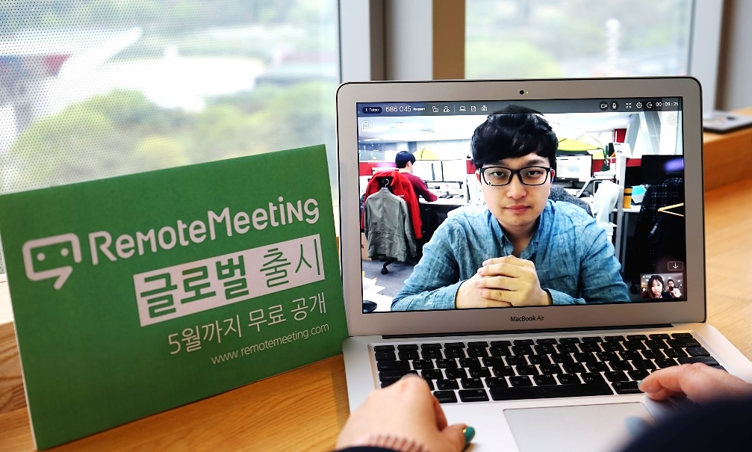
Hybrid Stand-up
SOFTWARE QUALITY CONFERENCE
PACIFIC NW
Start with an Asynchronous stand-ups followed up with a meeting.
This Photo by Unknown Author is licensed under CC BY-NC-ND
PNSQC ™

Slide 23
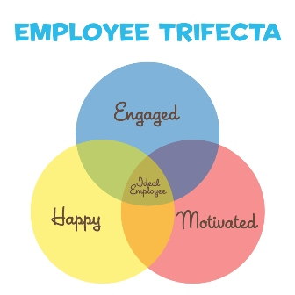
SOFTWARE QUALITY CONFERENCE
PACIFIC NW
The importance of building workplace relationships.
This Photo by Unknown Author is licensed under CC BY-NC-ND
PNSQC ™

Slide 24
SOFTWARE QUALITY CONFERENCE
PACIFIC NW
Wrapping up
PNSQC ™

Slide 25
Comments and Questions
SOFTWARE QUALITY CONFERENCE
PACIFIC NW
This Photo by Unknown Author is licensed under CC BY-SA
PNSQC ™

Slide 26
@dainpc
SOFTWARE QUALITY CONFERENCE
PACIFIC NW
linkedin.com/in/dain-charbonneau-a4257226
This Photo by Unknown Author is licensed under CC BY-SA-NC
https://www.facebook.com/dain.charbonneau
This Photo by Unknown Author is licensed under CC BY-ND
This Photo by Unknown Author is licensed under CC BY-SA
PNSQC ™

