Slide 1
Quality Assurance in an Agile Development Team Michelle Wu 2018 PNSQC

Slide 2
Background
Myself
I am Michelle Wu
B.S. and M.S. in Computer Science
Over 25 years experience in software testing
Have done testing on firmware, drivers, printing software, access points management software
Currently with a financial company managing a QA team

Slide 3
Background
Our development team
Build proprietary software to support our daily business workflow
Start using the Agile software development method about 10 years ago
Experiment various processes and approaches to improve team efficiency
Some work well
Some do not work at all
Some need to be modified to fit our needs
Identify the role that QA plays to fit into the Agile development team

Slide 4
Purpose of the presentation
To share with you…
The challenges we have
How we have resolved them
The role of our QA team plays in the different stages of the software development cycle

Slide 5
Agenda
Development team structure overview
Challenges
Solutions
QA lifecycle
QA process and workflow
Tools
Q&A

Slide 6
Development Team Overview
Project Teams
New features/applications development
Performance Team
Improve performance of our applications
Maintenance Team
Production escalations and minor feature backlog items
Tools Team
Development support tools, software deployment tools
We support:
67 Services (Windows Services & Web Services)
36 Applications (Desktop and Console Applications)
14 Data-bases (SQL & Mongo DB)

Slide 7
Releases
250+ Releases
(August 2017 – July 2018)

Slide 8
Challenges
Frequent Releases
Higher risk of breaking existing features
Huge overhead in running regression tests
Co-ordinate releases among teams on the release day
Solutions:
Maintain good regression test documents
Smaller releases
Automation – e.g. Validation logic, calculation logic
Review commits

Slide 9
Challenges
Developers are always ahead of QA in completing tasks
Solutions:
Fixed-length iteration (2 weeks iteration)
Developer and QA start and finish at the same time
Work well if we can accurately estimate the time needed to finish the tasks for the iteration
Either runs out of tasks to do or cannot finish all the tasks
Stop doing fixed-length iteration and release when we can
More automated integration tests
Make every task testable so that testing can go parallel with development
Developer help demo
Developer help with regression testing

Slide 10
Challenges
We are not building the right thing
Solutions:
Business Analysts (BA) define Acceptance Criteria
Test case review with business users
Frequent demo to business users, involving developers and BA
Pair User Acceptance Testing (pair UAT)
Agile development emphasizes TDD, no QA is needed
Misconception: Test automation is all we need
Manual testing is needed for end-to-end testing

Slide 11
QA Lifecycle
Requested Feature
Development.
(Demo,
Bugs)
Acceptance Criteria
Testing.
(UAT Feedback)
Test Case Development
User Acceptance Testing
(UAT)
(Demo)
Business
(Hot Fix/Warm Fix)
Business Approval
Test Case Review
Development/QA/Business Users
UAT Kickoff
Release
Post Release Support

Slide 12
QA Process and Workflow

Slide 13
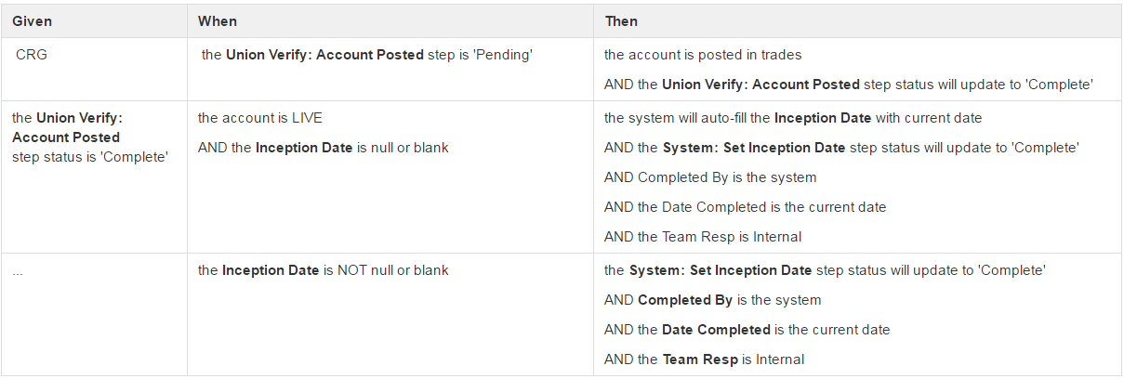
Acceptance Criteria

Slide 14
Test Planning and Test Case
Provide test steps and expected behavior
Show test coverage
Communicate what is being tested
Confirm we are testing the features in the right way
Fulfill compliance requirement
Submit test case along with the release ticket

Slide 15
Demo
Who and when?
Developer to QA
on-going effort during development cycle
Development team to business stakeholder
during development
Business stakeholder to business team
Introduce new features to the business team
Development team to Application Support and Maintenance Team
on release day or day after release

Slide 16
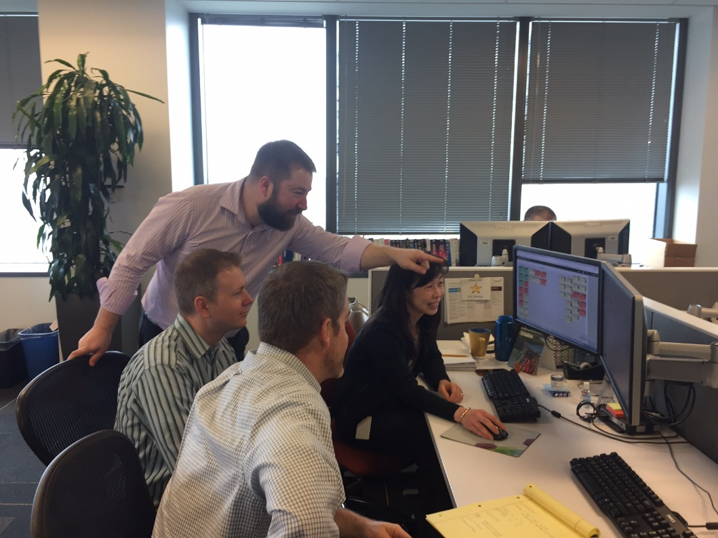
Demo
What do we do?
Communicate features
Confirm features
Do they fit your workflow?
Is the UI intuitive?
Get early feedback
Promote involvement

Slide 17
User Acceptance Testing (UAT)
What is User Acceptance Testing?
Actual software users test the software
When is UAT performed?
At the end of the development cycle of the release
Continuous UAT
How to prepare for UAT?
Keep user informed with the UAT schedule
Demo
What to look for in UAT?
Confirm that we built the right thing
Bugs like minor feature or cosmetic bugs

Slide 18
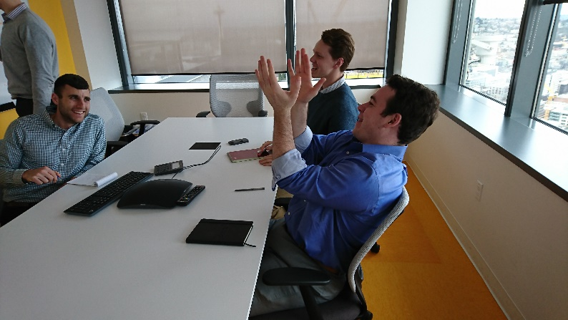
Ways to conduct User Acceptance Testing
Black Box Testing
Use Case Testing
Discovery/Exploratory Testing
Risk-Based Testing
Pair User Acceptance Testing

Slide 19
Prepare to release to production
Coordinate with the business
Obtain business approval to release
Coordinate with other releasing teams
Merge releasing applications if necessary
Stage releasing applications
Deploy all releasing applications to Integration environment
Run regression testing
Run regression tests on the Integration environment
Version control
Check all the releasing branches are not behind master branch
Application release ticket
Provide post deployment smoke tests
QA sign-off

Slide 20
Post release
Support release
Answer questions
Address concerns seen in production
Warm Fix
Bug introduced w/ workaround
Hot Fix
Work stoppage issue
Update documentation
Regression test documents
Helpful testing tips and scripts

Slide 21
Tools
Project Management
Leankit/Jira
Confluence Wiki (project stories, acceptance criteria, test cases)
Automation
Unit Tests
Integration Tests ( Specflow)
Postman (WebApi testing)
Logging
Kibana/Elk Stack
Application log files
Deployment
TeamCity (build agent and deployment)
Octopus (applications deployment)
Dobby (database provisioning)

Slide 22
Summary
Challenges
Frequent Releases
QA always behind
Not building the right thing
Agile development does not need QA
Solutions
Smaller releases
Every task is testable
Add more automated tests to reduce overhead in running regression tests manually in every release
Clear acceptance criteria and test case review
Frequent demo
UAT (pair, continuous)
Post release support

Slide 23
Summary
QA role
QA involves very early in the development lifecycle
QA plays an important role in every phase of the development cycle
From defining acceptance criteria to post release support

Slide 24
Thank You

