Slide 1
Influence of Architecture Validation on Performance Engineering
SOFTWARE QUALITY CONFERENCE
PACIFIC NW
KRITHIKA HEGDE
AMITH SHETTY
10/08/2018
PNSQC ™

Slide 2
When it comes to the overall performance of a system these are few questions that cross our mind
How well an application handles the incoming demand?
Given a maximum acceptable response time, what is the highest demand the web site can handle?
How will you handle unexpected load?
Which component is the bottleneck?
PNSQC ™
Notes:
How can we estimate the average response time?
How large should buffers be?
Do you drop additional request or downgrade response time for a higher throughput?
What are parameters do you decide on the elasticity?
Should it be upgraded or replicated?
How does the transmission rate of the data affect performance?

Slide 3
What is performance engineering
Roles / Skills
Performance Engineering
Best Practices
Tasks
Tools
Notes:
What is performance engineering :
performance engineering encompasses the defined set of rules/skills, activities ,best practices, tools and deliverables applied at every stage of development lifecycle to ensure that the design and implemented solution meets the functional and non functional requirements.
business requirements are well translated into software components and defining the Business requirement in terms transactional throughput- basically means when we are actually building a system we need to be very cognizant about the system being able to cater to like about 1000-2000 transactions per hour- from a business transaction not throughput from kb.
tools we use in our lifecycle
Eliminate system failures and rework – only when ppl reach production ->cost increase

Slide 4
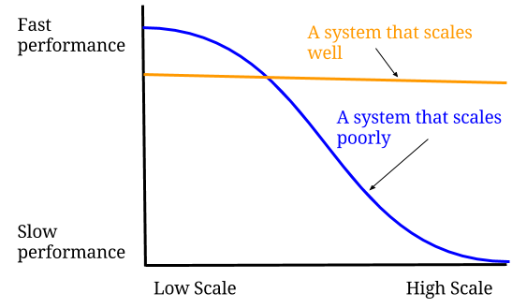
Differentiating Performance from scalability
Time-behavior
Resource Utilization
Capacity degree
Notes:
response times are too high or that the application cannot scale up to more than some large number of concurrent users?
Time-behavior: degree to which the response and processing times and throughput rates of an application, when performing its functions, meet requirements.
Resource Utilization: degree to which the amounts and types of resources used by an application, when performing its functions, meet requirements.
Capacity degree: to which the maximum limits of the application, parameter meet requirements.
Scalability on the other hand, is the ability of an application to handle a sudden increase in workload. The increase could come from a surge in simultaneous users, a rising amount of data being processed, or it could also arise from large number of individual requests for access. The increase could be from anything that places higher demand on available resources.

Slide 5
Reference Application
Third Party Plugin
Data Collection Service
Management Platform Core Services
DB
Event Aggregator Service

Slide 6
Perspectives on performance architecture
End User perspective
The response time is the sum of the processing time and waiting times taking into consideration the synchronization loses.
Process perspective
The performance consideration that need to be taken from the process perspective. It refers to the time required to complete one instance of a process which could involve multiple products, services etc., as opposed to the response time, which is defined as the time to complete one request.
Product perspective
As the above example consists of platform management system with several plugins/products we would need to consider the processing time for a product for a given workflow, the amount of time that actual work is performed for a certain product or outcome. In this scenario the response time is considered without waiting times. Hence it can be orders of magnitude lower than the response time.
System perspective
This perspective focuses on the performance consideration for a given system in the workflow. It can be considered as the throughput, the number of transactions/requests that are completed per time unit.
Resource perspective
In terms of performance utilization can be considered a measure for the effectiveness with which a resource is used. On the other hand, a high utilization can also be an indication of the fact that the resource is a potential bottleneck.
PNSQC ™

Slide 7
Detecting performance problems at design phase
Management Console
Event Management Service
Search Service
View Search Result
View Stored Events
Store Event Retrieved
Service Layer
Search Component
View Component
Event Aggregation Service
Implementation Layer
Database Query
Retrieve Results
Retrieve Event
Store Event
Infrastructure Layer
Data Access management
Datastore Service
Data access
Data upload
Data Store
Notes:
A service layer exposes external functionality that can be used by other layers, while an implementation layer models the implementation of services in a service layer.
Thus, we can separate the externally observable behavior (expressed as services) from the complex internal organization (contained within the implementation layers).
The implementation layer further relies on the infrastructure layer for serving the request that comes from the Service layers, like connections for database or network related operation between plugins.
In a layered view, analysis across layers is possible by propagating quantities through the layers.
Characterize based on whether the load propagated through the layers is rhythmic and regular, whether it varies seasonally or by time of day, whether it is growing over time, and whether it is inherently subject to potentially disruptive bursts of activity.
Once the workloads have been determined, we can determine the effort these workloads require from the system resources.
This effort can be expressed in terms of performance indicators: Throughput, System response time, Queue time for events, and Queue length for components.

Slide 8
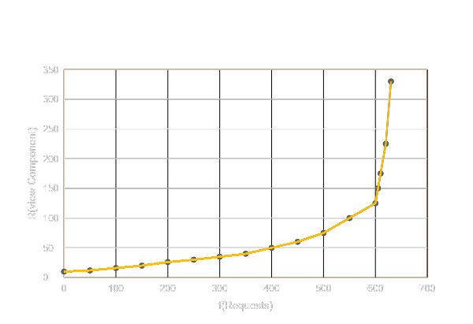
Workload Analysis
Resource(r) | Service(s) | λ (sec⁻¹) | S (sec) | R (sec) | U
Data Store | Data access | 0.0382 | 6.0 | 7.8 | 0.229
Data Store | Data upload | 0.0278 | 0.2 | 0.2 | 0.006
Data access Component | Retrieve results | 0.0313 | 12.8 | 25.0 | 0.488
Data access Component | Store events | 0.0069 | 12.8 | 25.0 | 0.488
DataStore Component | DB query | 0.0278 | 0.7 | 0.7 | 0.019
DataStore Component | DB update | 0.0069 | 0.7 | 0.7 | 0.019
Search Component | Search results | 0.0278 | 1.2 | 1.2 | 0.025
View component | View result | 0.0313 | 27.0 | 174 | 0.843
Event aggregator | Event aggr. | 0.0069 | 33.7 | 44.0 | 0.234
Notes:
The results show that the queuing times from the lower layers accumulate in the higher layers. The ‘view’ component of the platform management application has a utilization of over 81%, which results in a response time of the ‘view search result’ service of almost 3 minutes.

Slide 10
Architecture validation during development phase
Add checkpoints that are considered crucial in creating a feedback loop based on the inputs obtained during the runtime monitoring of system performance.
How adding a rule check for each these performance antipatterns helps in creating a feedback loop to the software architectural models.

Slide 11
Performance Antipatterns
Performance patterns illustrate “best practice” approaches to achieving responsiveness and scalability
Performance antipatterns illustrate how to identify a bad situation and provide a way to rectify the problem

Slide 12
Scattered Information
The information required by an object is scattered in several different places. The processing required to retrieve this information from different sources results in application suffering from performance problems.(Circuitous Treasure Hunt )
Rule Check:
Inspect if the software entity is retrieving a lot of information from a database.
Check if the software instance generates many database calls by performing several queries
The processing node on which the database is deployed might show high utilization value for CPU(s) and disk(s). A check needs to be added to capture rise of at least one of these values above the performance threshold boundary.
Notes:
The information required by an object is scattered in several different places.
The impact on performance is huge when the data is on remote server and each access requires transmitting all the intermediate queries and their results through the network.
In large customer environments we deal with huge result sets, one object invokes an operation on another object, that object in turn invokes an operation on another object, and so on, until the desired result is obtained. Then, each operation returns, one by one, to the object that made the original call.
This chaining of the method invocations at different objects requires an extra processing to identify the final operation to be called and invoked, especially in distributed object systems where objects involved may reside in other processes and on other processors.
The impact on performance degradation will be even greater, when every method invocation causes the intermediate objects to be created and destroyed. Allocation and De-allocation of memory on intermediate objects are performed frequently and consumes system resources.

Slide 13
Overusing database server for running code
As the database is a shared resource for multiple services it can become a bottleneck during high use.
Rule check:
Add a check to monitor database activity, make sure to add rules that run a mixture of suspected scenarios with a variable user load. Telemetry data can be used to support this test.
Check the source code for DB activity that reveals significant processing but very little data traffic.
Notes:
Ideal scenario it is more efficient to perform processing actions close to the data, rather than transmitting the data to a client application for processing.
If in a cloud environment where Database Transaction units are charged the runtime costs would be huge as the datastore would be metered.
Moreover, moving the processing into computing resource which are scalable horizontally would always be better.
By doing so we should take into consideration of not moving the processing, if doing so can cause the database to transfer far more data over the network.

Slide 14
An excessive number of requests is required to perform a task
Small amount of information is sent in each message. The amount of processing overhead is the same regardless of the size of the message. With smaller messages, this processing is required many more times than necessary
Rule check:
Consider a software entity that exchanges a huge number of messages with remote entities.
Check for inefficient use of bandwidth, by checking if the software entity under inspection is sending high number of messages without optimizing the network capacity. The process node on which this software entity is deployed needs to be checked for utilization of the network lower than the given performance threshold.

Slide 15
Stuffing of the Session
User session during the web site visit can be tracked using the Session object. It generally starts with putting very little information in the session, but over a period the session object keeps on growing. At times unnecessary/redundant information is stuffed into the session object.
Rule check:
Get details of what goes into the session object and filter out unnecessary information
Track objects that can be removed from the session when the usage is over
Check for objects that can be defaulted to request scope .

Slide 16
Role of concurrency models on Performance
Thread pool
In a thread pool model, the number of threads in the pool limits the throughput. For example, if all threads are blocked waiting for replies from backend servers no new requests can be handled, which can degrade the throughput of busy middle-tier servers.
Thread-per-request
In this scenario a thread will be created for every incoming request from a client. Server can create a number of threads as per request. This concurrency model may not scale when a high volume of requests spawns an excessive number of threads.
Thread-per-connection
We see that most of the server activity is I/O, like sending a request to another microservice or calling a database server. Therefore, at any given time, most of the threads will be idle, waiting for some I/O to return.

Slide 17
Let us further consider the problem with thread per connection
CPU
Thread switching is considered very expensive. The OS may switch between threads at any time and needs to save the entire thread state so that it can restore it when it switches back. For 10,000 threads, the overhead of switching takes up more than 40% of the CPU resources.
Memory
Each thread would need a stack for all its function parameters, return values and local variables, which is large enough to prevent a stack overflow. If we consider a standard stack size of 1MB, for example, we will be dealing with 10GB of memory for 10K connections.
I/O
We see that most of the server activity is I/O, like sending a request to another microservice or calling a database server. Therefore, at any given time, most of the threads will be idle, waiting for some I/O to return.

Slide 18
How the use of event loops helps dealing with above issues
In today’s market, we have access to many technologies which have implemented a paradigm known as event loops.
These servers use a single-thread which runs through a loop of CPU-bound code, using callbacks to manage I/O completion.
In these cases, I/O is implemented using the operating system’s asynchronous APIs. This method deals with all the drawbacks previously discussed
Notes:
CPU – In the case of CPU intensive code, the event loop is blocked from proceeding. In other words, if one client has a large workload, all the others must wait.
Multiple cores – Only one thread means that only a single core is used, so in the case of a multi-core CPU, the server will not utilize all available resources, unless additional instances are used.
Code – Handling callbacks is very complicated on a programming level. Node.js and other event loop servers take a technical detail of asynchronous event handling from the OS, and place it in the hands of the developers. This requires writing code differently. Of course, with experience, programmers can get quite good at this, but it certainly isn’t as simple and straightforward as sequential code.
We saw previously that for 10K threads using 1MB each we need 10GB, which is costly. Go’s approach is to allocate a very small stack by default for each routine, and then to increase and decrease the stack size dynamically according to the actual needs of the routine. The Go compiler analyzes the code and identifies how much stack space each function needs. If there is a chance that a function will need more stack space, the compiler inserts a runtime evaluation of the stack pointer to see if it is necessary to increase or decrease the stack size in real time. In this way, Go can start with a very small default stack size of only 2KB. Thus, for 10K server requests, we start out only using 20MB of memory for stack space instead of 10GB using threads with a standard fixed stack size of 1MB.

Slide 19
Extraction of architectural performance models from execution traces
1
2
3
Improving the current techniques of using system log messages to evaluate software performance properties.
Retrieve the log information , parse it, and store it in an in-memory compact data structure
After data is gathered, visualizing the data can sometimes reveal the problem quickly without requiring further complicated analysis
4
5
6
if the system is experiencing memory pressure, any performance analysis tool can be used to visualize and summarize performance counters related to garbage collection or memory usage.
Define threshold values for a given counter, compares counter values (or their statistical properties, i.e., means, medians, and quantiles) against the predefined threshold values. Performance counters that violate their threshold are reported back.
Using the steps above, the developers may be able to find what counters behave abnormally, which will help in troubleshooting performance issues.

Slide 20
Implementing architecture validation into build process
Performance Requirements
Analyze
Software Artifact
(Design Model, Code)
Metrics Calculation
Threshold binding
Performance requirement fulfillment
Rule check for performance antipatterns
Design Refactoring
Notes:
As part of agile dev methodology it is required to test using stable build
Therefore need to trigger automatedarch rule check framework within the build process. Results as with func test could be Junit or html reports

Slide 21
Architecture validation rule checks using tools
Notes:
The most sophisticated tools merely perform statistical analysis on performance metrics and give average resources consumed by the different components/classes. When profiling large enterprise applications, the amount of information recorded can be truly overwhelming
It can be difficult and time consuming for developers that have to analyze the data produced by these tools in search of particular problems.
The tools, however, do not focus on analyzing the system from a design perspective. Thus, design flaws can easily go unnoticed.

Slide 22
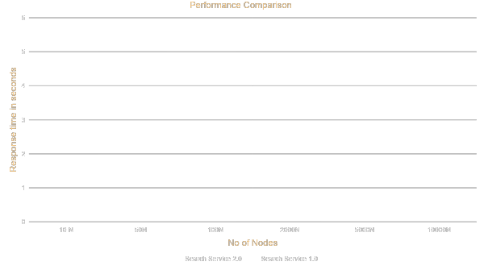
Performance Comparison of feature implementation between 2 different builds
Notes:
To be able to deduce the run-time design from an application we need to identify the relationships that exist between the different components that make up the system. These relationships can be captured by recording run-time paths. There are commercial application monitoring tools, such as DynaTrace. Which uses its own PurePath technology which captures timing and context for all transactions across all application tiers. It has support for both Java and .NET environments. These paths maintain the order of calls between components they also capture communication patterns between the components. Such communication patterns can be analyzed to identify inefficient communication between components. We can also deduce performance metrics (such as CPU and memory usage) on the component methods. Below is a sample architecture validation rule snippet available through Dynatrace

Slide 23
Decision tree for performance implementation
Cost effective
Cost effective
Cost effective
Cost?
Cost?
Cost?
Implement horizontal scaling
Implement Performance tuning
Implement vertical scaling
Too expensive
Too expensive
Too expensive

Slide 24
Conclusion
Which of the above below approaches should be considered depends on a series of factors
Invest time in improving the performance of the application right from the initial stages of the development lifecycle
Migrating the application or individual tiers to nodes with greater capacity- which is also known as Vertical Scaling.
Instead of adding more resources, which is in the case of vertical scaling, a web application or its tiers are decoupled so that demand is spread out among multiple nodes- which is also known as horizontal scaling.
Notes:
What factor is too expensive totally depends on the current state of the app
Vertical scaling an application or its diff tiers – if incorporating design checks rigt from the start
Horizontal scaling-if service providers or data centers are unable to provision vert

Slide 25
SOFTWARE QUALITY CONFERENCE
PACIFIC NW
Thank you
PNSQC ™

