Slide 1
Timeless Skills for Modern Testers
Communication, Collaboration & Creativity
Gerie Owen
Notes:
Interaction bias: The user (you and me!) biases an algorithm by the way we interact with it. As an example, Google asked users to draw a shoe. Users drew a man’s shoe, so the system didn’t know that high heels were also shoes.
Latent bias: The algorithm incorrectly correlates ideas with gender, race, sexuality, income, etc. This is the idea of correlating “doctor” with men, just because that’s what stock imagery says.
Selection bias: The data used to train the algorithm over-represents one population, making it operate better for them at the expense of others. If image recognition is trained only on white people, they’ll win AI-judged beauty contests.

Slide 2
Gerie Owen
Testing Strategist & Evangelist
Test Manager
Subject expert on testing for TechTarget’s SearchSoftwareQuality.com
International and Domestic Conference Presenter
gowen@gerieowen.com

Slide 3
Testers are the Champions of Quality!

Slide 4
Testers are the Champions of Quality
Modern testers across all industries are challenged to champion quality in new and unique ways.
In Agile and DevOps, we must evangelize building quality in and use new test techniques to increase velocity and quality while streamlining processes.
As champions of the customer and guardians of our organizations’ digital reputations, we are uniquely positioned to enable digital transformations by transforming our test processes to be customer centric and focused on delivering business value.

Slide 5
Quality Requires Innovation
Testers must innovate; quality assurance and testing in these methodologies is no longer business as usual.
Building upon and extending our current skills, techniques, approaches and methodologies will not meet the challenge.
True innovation doesn’t happen in a vacuum; it almost always requires the intersection of seemingly disparate fields.

Slide 6
The Skills of Innovation
Communication
Collaboration
Creativity

Slide 7
Testers Champion Communication

Slide 8
Communication is Hard!
Multitasking

Slide 9
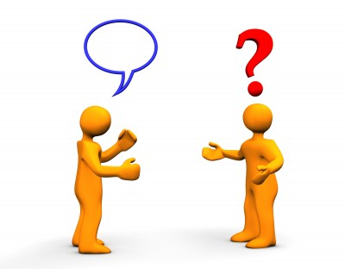
Communication is Hard!
Conversation is unpredictable

Slide 10
Communication is Hard!
We are attached to our Devices

Slide 11
What we lose through our devices
Spontaneity
Flow of random ideas
Unexpected solutions
Unexpected problems
Most important
Practice

Slide 12
Role of Communication
Streamline processes
Share insights
Get work done
Solve problems

Slide 13
Lead by Communicating
TALK….TALK…..TALK
Design for Communications
Communicate by Example
Include Geographically Dispersed Teams

Slide 14
Designing for conversation
Put people together in non-meeting settings
Lunchroom
Offsites
Work spaces
Standups

Slide 15
Communication By Example
Put ALL electronic devices away during meetings
Provide time for conversation
Don’t send mixed messages

Slide 16
Include Distributed Teams
Introduce personalities into calls
Get the team together occasionally
Use multiple communications channels

Slide 17
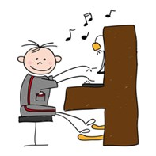
Why talk?
You solve problems more quickly
You address issues you never knew you had
You establish trust
You get practice

Slide 18
What Happens When We Don’t Communicate
Chaos!!!!
Can anyone describe a issue the root cause of which is lack of communication?

Slide 19
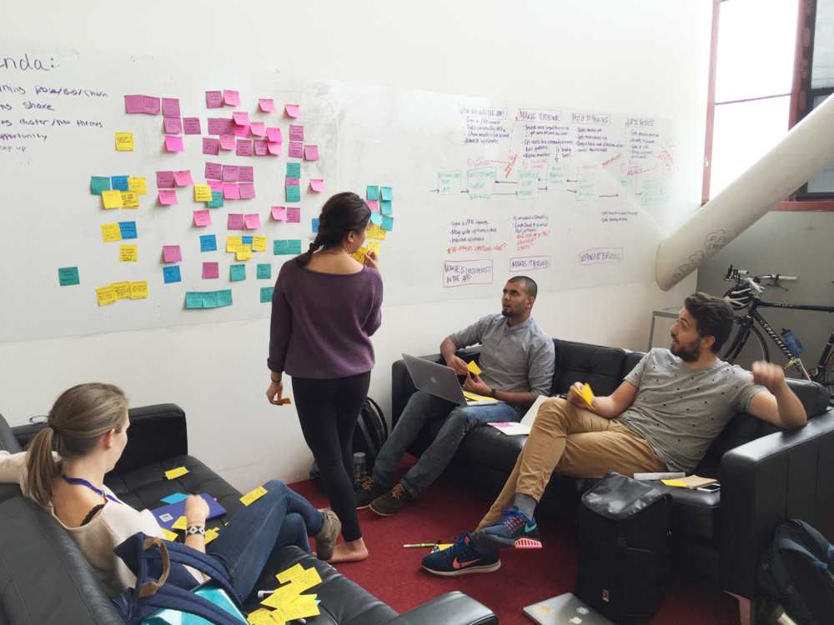
Communication is the foundation
Critical to COLLABORATION
Leads to CREATIVITY

Slide 20
Testers Promote Collaboration

Slide 21
What is Collaboration?
Working together to create!

Slide 22
Why Collaborate?
You Learn About
Yourself
Others
Intersection of Ideas
Creates Energy through Disagreement
Creates new possibilities

Slide 23
How to Collaborate
Listen more than talk
Respect the opinions and embrace the ideas of all team members
Place the importance of project and the Company over the individual
Examine the advantages and disadvantages of each potential solution
Be open to creating a mix of multiple ideas

Slide 24
Lead by Collaborating
Foster transparency and respect
Set Expectations
Use Technology effectively
Drive Innovation through creativity

Slide 25
What Happens When We Don’t Collaborate
Silos!!!
Can anyone give examples of lack of collaboration?

Slide 26
Testers Drive Creativity and Innovation

Slide 27
Creativity and Innovation
This is the highest level of the soft skills hierarchy. Without communication, you don’t get collaboration, and without collaboration, you can’t have creativity.
It is a myth that creativity is often accomplished by a single person working alone.
Instead, creativity is based on building on what others have done in the past, exchanging ideas freely to develop a unique solution.

Slide 28
All Companies Need Innovation to Succeed
I worked for an organization that waited until competitors produced a given product or feature, then scrambled to duplicate it. While they achieved some Sales success, we were seen in the industry and by many customers and prospects as laggards.
Ultimately, this perception dragged down our business to the extent that we were soon sold off to one of those competitors, who killed our products.

Slide 29
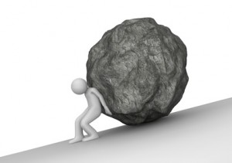
Why is Creativity and Innovation Difficult?
Our “Innovation” is incremental; we build upon our current knowledge and expertise.
We collaborate with colleagues from within our own field, we “innovate” the same old ideas.
We may improve on our processes; but we don’t create anything truly new in direction

Slide 30
How Should We Innovate?
True innovation cannot come from only one field of study.
Groundbreaking Innovation comes from “The Intersection” of multiple disciplines

Slide 31
Innovation comes from the Intersection
Frans Johansson describes “The Intersection” as the place where:
Different cultures, domains and disciplines connect
Established concepts clash and combine
through which groundbreaking new ideas are generated
Stepping into the Intersection is known as the “Medici Effect”

Slide 32
Where do we find Intersections?
We can find both within ourselves as well as within our teams.
Our fields of study are not just our careers, they are everything that we are involved in.
In today’s world of Agile, DevOps and distributed teams, we collaborate with colleagues from many different, often disparate areas of expertise.
This is a good thing!

Slide 33
My Own Intersection
I am a Software Tester
I am a Marathon Runner
I am a cat Mom
I am a fashion designer
How many fields are you in?

Slide 34
What are the Characteristics of Innovators?
Innovators are:
Exposed to many disciplines and cultures
Curious and self-taught in many fields of study
Most Importantly, they have:
Low Associative Barriers

Slide 35
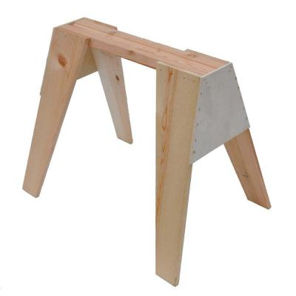
Finding the Intersection
It’s not just about putting together seemingly unrelated fields
It’s finding the relationships between them
And we find relationships by
Lowering Associative Barriers

Slide 36
What are associative barriers
Our minds analyze problems by association
We solve problems based on past successful actions
Useful in most situations, however
Association doesn’t encourage different perspectives or exploring unrelated concepts
The more we associate, the less we create
Notes:
Johansson tells us that the best ways of lowering associative barriers is to reverse assumptions and look at an issue from at least three different perspectives, but I believe there are more ways.

Slide 37
Lowering Associative Barriers
Be Aware of our Biases
Have a Growth Mindset
Think without Thinking

Slide 38
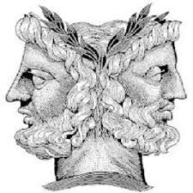
How do Biases Support Associative Barriers
We maintain certain beliefs which may or may not be factually true
We may be predisposed to believe something that affects our work and our conclusions
Biases impact our ability both to analyze and to associate freely

Slide 39
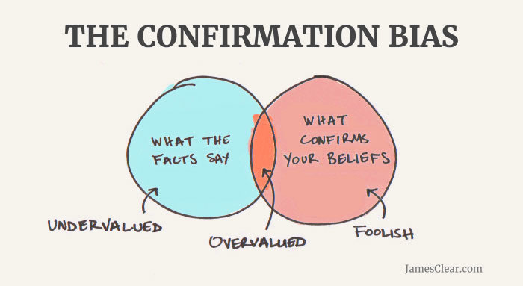
Biases that Support Associative Barriers
Representativeness
People tend to make judgements about situations based on how similar the situation under consideration is to others with which they are familiar.
Confirmation Bias
People consider only the information which supports what they have decided is true.

Slide 40
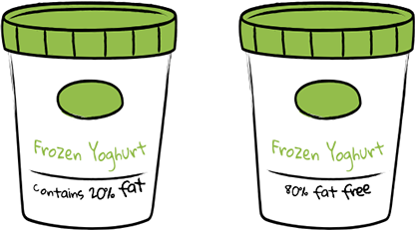
Biases that Support Associative Barriers
Congruence
The tendency of experimenters to plan and execute tests on just their own hypotheses without considering alternative hypotheses.
Framing
People react differently to choice depending upon how the information was presented. People avoid risk when a positive frame is presented and take risk when a negative frame is presented.

Slide 41
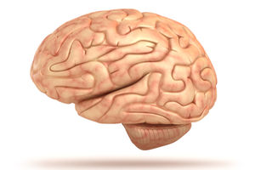
What is a mindset?
Developed by psychologist Carol Dweck
How we mentally approach life and its challenges
Why brains and talent don’t bring success
How they can stand in the way of it
Why praising brains and talent doesn’t foster self-esteem and accomplishment, but jeopardizes them

Slide 42
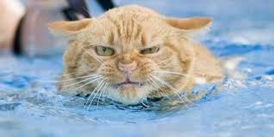
Characteristics of a fixed mindset
We are either smart or dumb
We have to continually prove ourselves
Failure is a personal reflection on our intelligence
Notes:
Can you think on someone who has a fixed mindset?

Slide 43
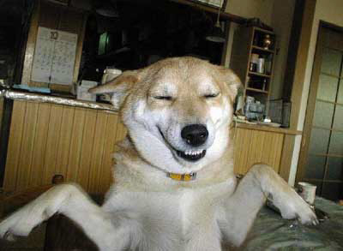
Characteristics of a growth mindset
We can work to improve our intelligence and abilities
What we have now is only a starting point
We accept failure as a learning process
Notes:
Can you think of someone who has a growth mindset?

Slide 44
Think without Thinking
Our Adaptive Unconscious
Mental processes that work quickly with little information
There are positives and negatives to this
Malcolm Gladwell terms this “Thin-Slicing”
By allowing ourselves to make quick assessments about ideas without association to other ideas

Slide 45
A Team’s Intersection
The Honey Pot Story

Slide 46
Testers….We are the Champions
Testers Champion the Quality Process Through:
Communication
Collaboration
Creativity Driving Innovation

Slide 47
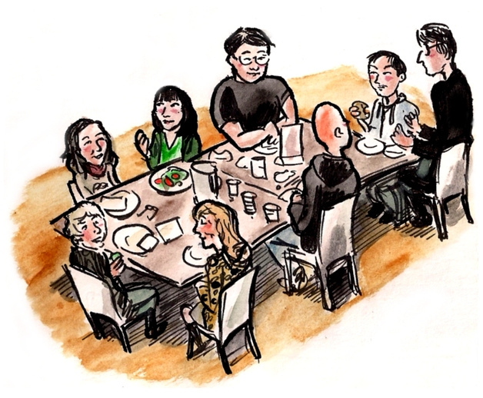
Step Into The Intersection
At your lunch table
Ask each person what fields they are in both professionally and personally
Find the intersections

Slide 48
References
The Medici Effect: Breakthrough Insights at the Intersection of Ideas, Concepts, and Cultures, by Frans Johansson
Thinking, Fast and Slow, by Daniel Kahneman
Blink: The Power of Thinking without Thinking, by Malcolm Gladwell
Reclaiming Conversation: The Power of Talk in the Digital Age, by Sherry Turkle
Mindset: The New Psychology of Success by Carol S. Dweck

