Slide 1
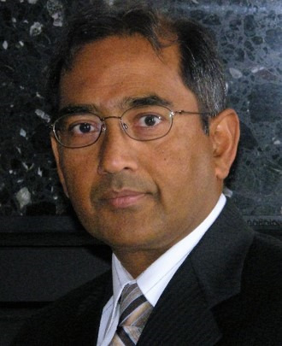
Integrating Security into Software Development Life Cycle
SOFTWARE QUALITY CONFERENCE
PACIFIC NW
Bhushan Gupta October 15, 2019
PNSQC ™

Slide 2
About Me
SOFTWARE QUALITY CONFERENCE
PACIFIC NW
Vegetarian

Slide 3
Key Take Aways
SOFTWARE QUALITY CONFERENCE
PACIFIC NW
Adding security stories to backlog
Prioritizing stories based upon threat
Building an acceptance criteria and security controls
Validating stories at different stages in an iteration
Prioritizing vulnerabilities
PNSQC ™

Slide 4
Agenda
Why shift left?
Stakeholders
Infusion of security – stories, personas, and acceptance Criteria
Security controls
Testing Approach
Vulnerability Assessment

Slide 5
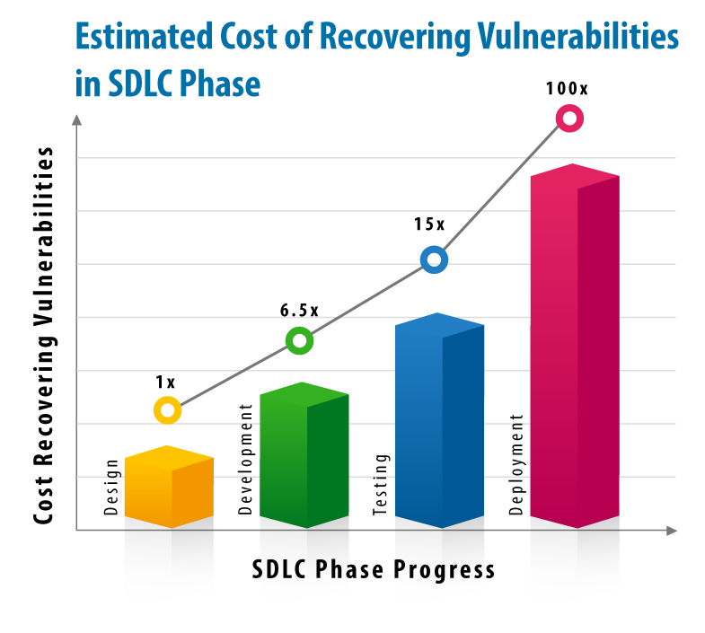
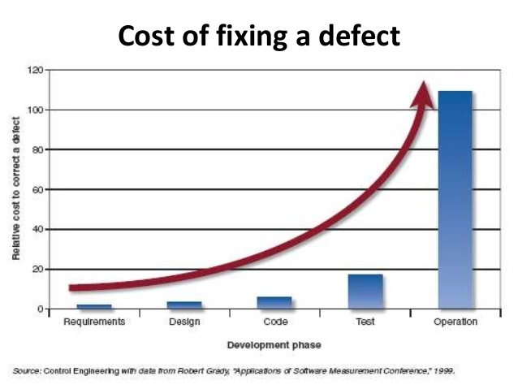
Cost of a Vulnerability
SOFTWARE QUALITY CONFERENCE
PACIFIC NW

Slide 6
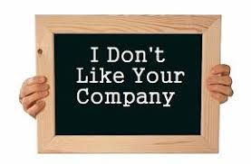
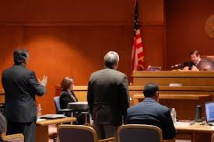
Other Impacts
SOFTWARE QUALITY CONFERENCE
PACIFIC NW
Image
Forensic and Repair
Notes:
On July 24, 2019 Facebook was fined $5B for the Privacy Violation

Slide 7
Stakeholders bring complexity
SOFTWARE QUALITY CONFERENCE
PACIFIC NW
Government
Industry
Business
Compliance
C
Best Practices
Development
Environment
Deployment
Environment
I
A
Policies
NIST
Notes:
Those are the basics of the security – Business Requirements per say. To support those requirements – you also need to make sure that your build and deployment environments are good.

Slide 8
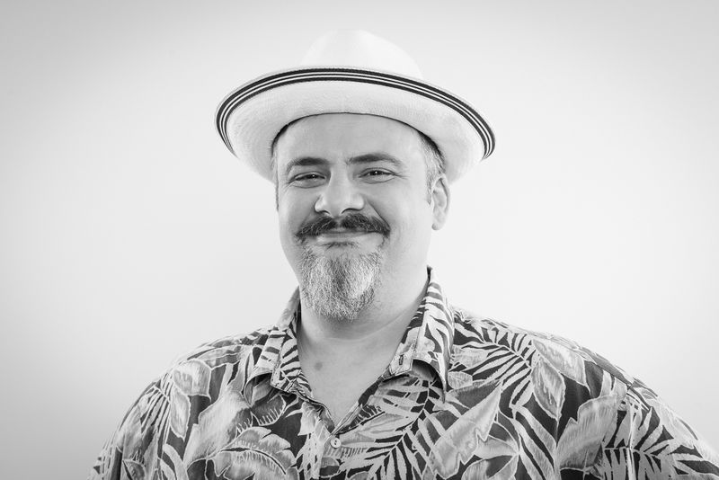
Bond Between Security and Developers
SOFTWARE QUALITY CONFERENCE
PACIFIC NW
Liz Rice, Technology Evangelist for Aqua
"If you can push security as far as you can toward developers, it's a good thing, because you can catch problems earlier. Dependency graph can shift security very far left."
Jim Manico, Manicode Security, OWASP
“Software engineers are security engineers.”
Notes:
You can’t be more blatant than this. Just the security engineer and manager do not own the security it’s a joint effort.

Slide 9
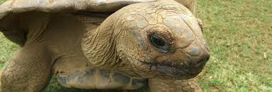
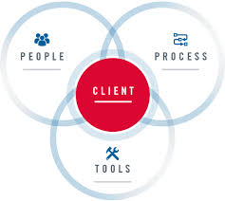
Considerations for Security Integration
SOFTWARE QUALITY CONFERENCE
PACIFIC NW
Faster, faster
Slowing me down!!
Lets set some goals!
Be
Cautious

Slide 10
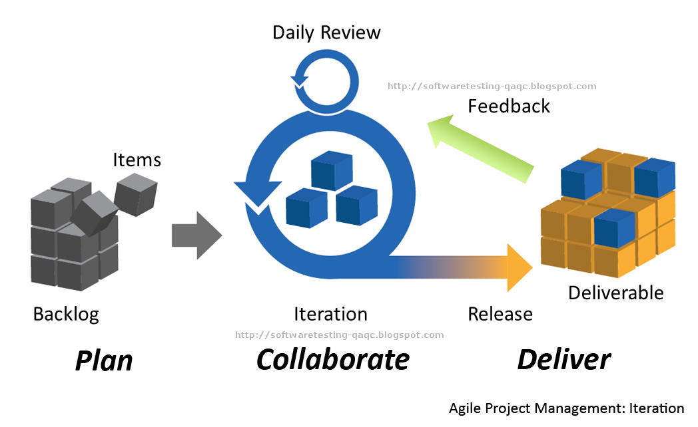
Security + Agile SDLC
SOFTWARE QUALITY CONFERENCE
PACIFIC NW
Security EPIC/Feature/Stories
Notes:
In our development method, I am taking the Agile development method, we would now integrate our security controls as stories.
EPIC – will be build a secure web site
Feature – Maintain Data Integrity.

Slide 11
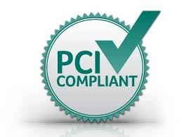
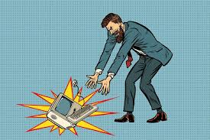
Security Personas
SOFTWARE QUALITY CONFERENCE
PACIFIC NW

Slide 12
Story Integration Concept
SOFTWARE QUALITY CONFERENCE
PACIFIC NW
Assess Risk using STRIDE
Create Acceptance Criteria
Build Security Controls
Validate Security Controls
Security EPIC/Feature/Stories
Notes:
In our development method, I am taking the Agile development method, we would now integrate our security controls as stories.
EPIC – will be build a secure web site
Feature – Maintain Data Integrity.

Slide 13
Integration into Agile Development
SOFTWARE QUALITY CONFERENCE
PACIFIC NW
How would
You test this?
EPIC/Feature: Maintain Data Integrity
Stories:
As a customer I want to buy a merchandise without revealing my credit card information
As a customer I don’t want anyone to know what I have purchased
As a hacker I want to steal credit card information
Acceptance Criteria:
Data is encrypted with AES
Data is transmitted using secure protocol
Notes:
Here are the stories along with the acceptance criteria. Lets look at the 1st story. To make support that story – we have come up with the acceptance criteria.

Slide 14
Feature – User Signup
SOFTWARE QUALITY CONFERENCE
PACIFIC NW
 | Stories for User Sign Up
Story 1 | The user browses to the site and initiates Signup process
Story 2 | The user creates a profile according to site specifications
Story 3 | The user establishes a UserID and a password
Story 4 | The user information is protected in motion and when stationary
Story 5 | The user receives registration confirmation
Story 6 | The user is logged out and logs back in again

Slide 15
STRIDE Approach to Vulnerability
SOFTWARE QUALITY CONFERENCE
PACIFIC NW
Category | Description
Spoofing | Gaining Access to the system using false identity
Tampering | Unauthorized modification of data
Repudiation | Ability to successfully deny an activity already taken place
Information Disclosure | Unwanted exposure of private data
Denial of Service | Making system unavailable for use
Elevation of Privilege | Assuming identity of a privileged user from limited privileges
Notes:
STRIDE is an approach promoted by Microsoft. It looks at the ways how security of a function can be breached.

Slide 16
STRIDE MAP – Feature Sign UP
SOFTWARE QUALITY CONFERENCE
PACIFIC NW
Story ID/ Vulnerability | Spoofing | Tampering | Repudiation | Information Disclosure | Denial of Service | Elevation of Privileges | STRIDE Score
1. Browse to Web Site | No | No | No | No | YES | No | 1
2,3,4 Create user Profile, login, security questions | Yes | No (data stationary) | Yes | Yes – social engineering | No | No | 2
5.Submit form | Yes | Yes | Yes | Yes – social engineering | Yes | Yes | 5
6. Receive Confirmation | No | Yes | Yes | Yes (MitM) | Yes | No | 4

Slide 17
High Level Security Acceptance Criteria for Sign Up
SOFTWARE QUALITY CONFERENCE
PACIFIC NW
Only business-necessary information gathered from the client
User entered data in the forms does not introduce vulnerabilities (injection – SQL, Command Line)
Confidentiality of the data is maintained in motion
Integrity of the data is maintained in motion
Data stored in the database matches exactly with what was provided by the user
Data integrity is maintained while in storage
User required to confirm the PII on submission for non-repudiation

Slide 18
Security Controls for Sign UP
SOFTWARE QUALITY CONFERENCE
PACIFIC NW
Hide user input especially user ID and password
Validate user ID and password credentials
Sanitize user input
Encrypt all data elements before transmission
Use secure socket layer
Use prepared statements
Validate data prior to storing in the database
Terminate the session

Slide 19
Acceptance Criteria – Story 6, Login
SOFTWARE QUALITY CONFERENCE
PACIFIC NW
Spoofing | Client unable to enter malicious information (injection attack)
Tampering | Data secure while in motion with compatible browsers Login event recorded for auditing (both successful & Unsuccessful)
Repudiation | Not applicable
Information Disclosure | Social engineering such as shoulder surfing is not possible Secure Session (No MitM attack)
Denial of Service | Does not cause network overload
Elevation of Privilege | Client unable to enter malicious information (injection attack)

Slide 20
Security Controls – Story 6, Login
SOFTWARE QUALITY CONFERENCE
PACIFIC NW
Spoofing | Validate client data, Use of prepared statements
Tampering | Secure Network Protocol, Data Encryption Update logs
Repudiation | Not applicable
Information Disclosure | Hide password while entering Impalement Session Securing Methods
Denial of Service | Resolve any handshake problems between the client and the server
Elevation of Privilege | Validate client data, Use of prepared statements

Slide 21
Test Planning Approach
SOFTWARE QUALITY CONFERENCE
PACIFIC NW
Test Environment
Test most vulnerable function first – priority order
Test like a hacker – penetration testing
Understand/quantify risk
Support risk mitigation plan

Slide 22
Multi-prong Approach
SOFTWARE QUALITY CONFERENCE
PACIFIC NW
Prongs:
Reviews/Inspections - Design and Raw Code
Compiled Code – Static Code Analysis
Environment Verification (System Hardening) – Human Interaction
Code in Execution:
Security Focused Traditional QA Testing – Against security controls
Web Scanning using Scanners (ZAP, Burp Suite)
Dynamic Code Analysis (Veracode, Fortify)
Penetration Testing

Slide 23
Code Reviews/Inspections
SOFTWARE QUALITY CONFERENCE
PACIFIC NW
Targets:
Development Environment
Opsys and Language shortcomings – Buffer Overflow
Process and User Access Rights, (Admin vs. normal user)
Input Validation – both on client and server side
Coding Practices - Use of prepared statements vs. dynamic queries
Runtime Environment Verification – System Hardening

Slide 24
Static Code Analyzer
SOFTWARE QUALITY CONFERENCE
PACIFIC NW
Function
Shortcomings
Runs on compiled code with Debug on
Analyzes warning relevant to security problems
Provides a log of potential vulnerabilities
Provides a numeric index
False Positives
Requires resources
Tools:
Veracode and Fortify (HP)

Slide 25
Dynamic Code Analyzer
SOFTWARE QUALITY CONFERENCE
PACIFIC NW
Function
Shortcomings
Works on binary code
Simulates vulnerable scenarios
Quantifies app vulnerability
False Positives
Requires resources
Tools:
Veracode and Fortify (HP)

Slide 26
Environment Hardening
SOFTWARE QUALITY CONFERENCE
PACIFIC NW
Reinforce your environment:
Configuration management policy
Versioning – apply updates immediately
Change Control
Login level – Admin vs user
Principle of Least privilege
Change Default Settings – File path, access rights, password
Disabling unnecessary features

Slide 27
Testing Map for a Story – What, When and Who: Login
SOFTWARE QUALITY CONFERENCE
PACIFIC NW
3 ws | Review | Structured Testing | Static C A | Dynamic C A | Scanner | Hardening
What | Input Sanitization
When | Coding
Who | Developers + QA

Slide 28
Quantifying and Comparing Risk – DREAD Method
SOFTWARE QUALITY CONFERENCE
PACIFIC NW
DREAD Index = (DAMAGE + REPRODUCIBILITY + EXPLOITABILITY + AFFECTED USERS + DISCOVERABILITY) / 5

Slide 29
Quantifying and Comparing Risk
SOFTWARE QUALITY CONFERENCE
PACIFIC NW
Category | Value = 0 | Value = 5 | Value = 10
Damage Impact (data) | None | Few users only | Entire system
Reproducibility | Very hard | Few steps required | Use of web browser
Exploitability | Advanced knowledge | Use of kits | Just a web bowser
Actual Users Impacted | None | Some but not all | All users
Discoverability (application) | Easy – apparent Public Domain/Web browser | Guessing | Very hard (need special efforts)

Slide 30
CVE – Common Vulnerabilities and Exposure
SOFTWARE QUALITY CONFERENCE
PACIFIC NW
CVE® is a list of entries—each containing an identification number, a description, and at least one public reference—for publicly known cybersecurity vulnerabilities.
CVE Database provided by NIST
Provides Severity and Testing Approach
https://cve.mitre.org/cve/

Slide 31
Conclusion
Integrating security does not require a paradigm shift
Include security personas/actors
Build security control
Follow your iteration activities
There is NO NEW NORMAL

Slide 32
Backup

Slide 33
Risk Mitigation Levels
SOFTWARE QUALITY CONFERENCE
PACIFIC NW
EPIC: Overall System Risks
Organization is Interested
CISO
Feature: Sub-System Risk
Security Manager
User Story Risk
Security Engineer
Notes:
Risk mitigation is something we always pursue. The risk mitigation can be done in silos or it can be integrated at every level.
You should have a high level plan – if system gets breached (CSIO)
Evaluate on a feature basis – for example DDOS – what will be your plan (Security Manager)
Anticipate and Mitigate at story level – (security engineer)

